Slide 1
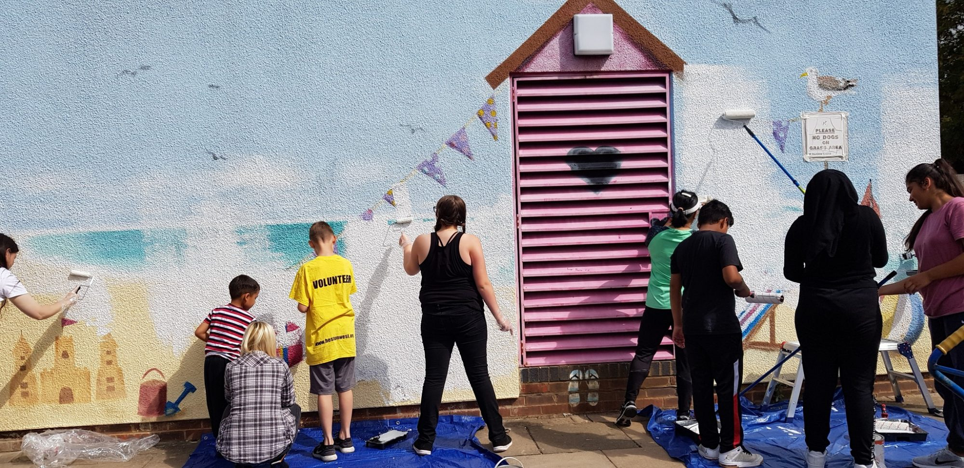

Recruitment Pack
Head of Strategic Development
‘The team at Ealing and Hounslow CVS are incredibly knowledgeable and always keen to support and connect local groups; their insight into the ever-changing landscape of third sector funding has been invaluable. Such progress has enabled new groups in Ealing and Hounslow to emerge, as well as established ones to continue support their local community’
EHCVS

Slide 2
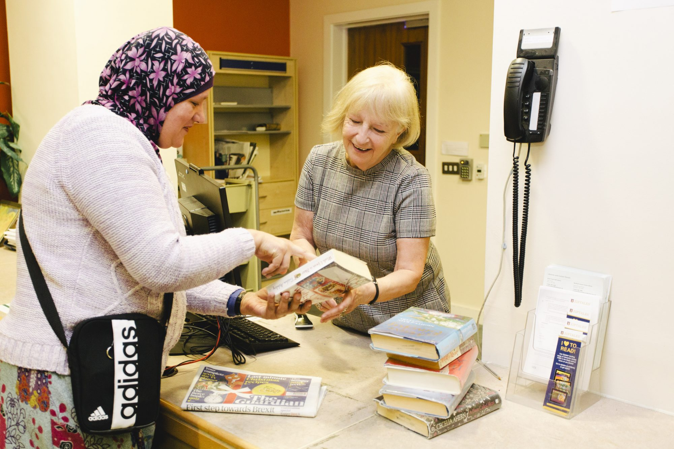

About Ealing &
Hounslow CVS
Ealing and Hounslow Community Voluntary Service (EHCVS) is a registered local charity that has supported voluntary and community sector (VCS) groups in Ealing for over 40 years and, since 2012, in Hounslow.
In an ever-evolving landscape where the voluntary sector faces ongoing challenges and new opportunities, EHCVS needs to continuously review and refine its strategic direction. Engaging with stakeholders has been valuable, enabling us to assess how effectively we have delivered the core priorities outlined in our latest Business Plan—developing, connecting, representing, and innovating with the third sector in Ealing and Hounslow. This consultation has helped us identify emerging priorities to enhance future service delivery.
As a second-tier organisation, EHCVS works closely with local charities and voluntary organisations, providing professional and impactful support. Our primary goal is to strengthen the voluntary sector by offering tailored assistance, facilitating collaborative consortia, and securing significant funding opportunities. Through these efforts, we strive to empower local organisations and improve the quality of life for the communities we serve.

Slide 3
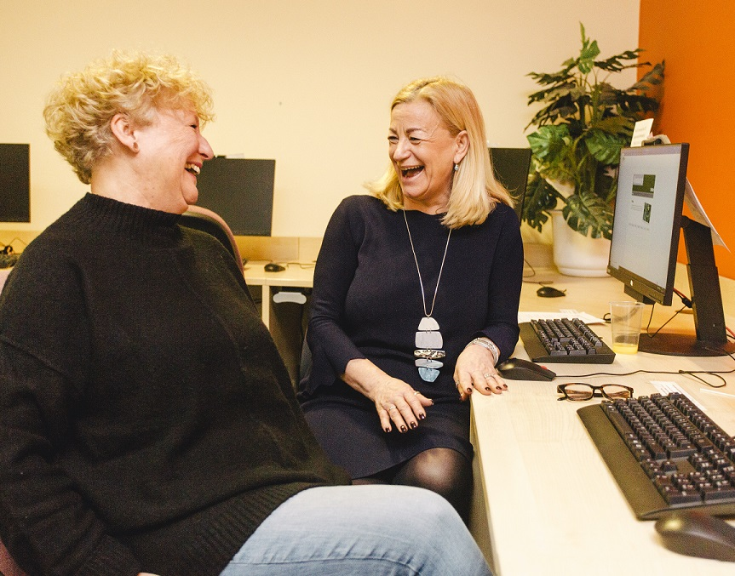

About Us
We are currently a team of 10, boasting a diverse range of backgrounds and skillsets. To find out more, read about each of our team members.
You can also learn more about our Trustees here, too.

Slide 4
Our Aims and Values
EHCVS’s aim is to deliver an improved quality of life for the less advantaged people in Ealing, Hounslow and surrounding areas.
We achieve this through:
Assisting local charities and volunteer organisations to operate more effectively.
Working with partners in undertaking projects.
Undertaking projects directly.
Our promises to our funders are to:
Work to achieve the agreed deliverables within the proposed timescales and costs;
Where problems, or concerns may arise, to advise the funder at the earliest practical time and to work with them to obtain a mutually satisfactory resolution;
Where we are working directly with local people to ensure that we obtain adequate feedback on their satisfaction with the service we are offering.
Our promises to our staff are to:
Help them to work together in a constructive manner to achieve our agreed deliverables;
Ensure that their progress on projects can be tracked and assistance provided at the earliest opportunity to overcome any problems and concerns that may arise.
Develop their skills and opportunities to take on different types of work.
Ultimately, it is the aim of EHCVS to be the most efficient and effective provider of these community services in London.

Slide 5
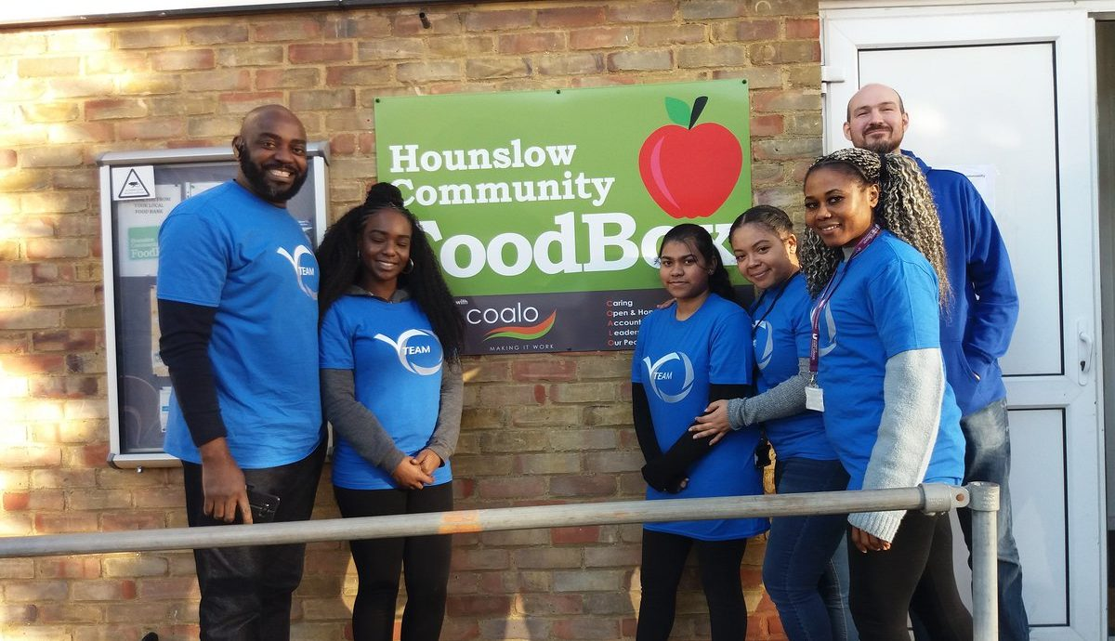
Our Strategic Objectives
Ealing and Hounslow CVS have ambitious plans for the future, and to achieve them, we recognise the need for continuous evolution and innovation in our working methods.
At the heart of our approach is a steadfast commitment to partnerships—collaborating with individuals, organisations, and businesses that share our vision of building, inspiring, developing, and empowering communities and volunteers to drive meaningful local change.
We are dedicated to strengthening engagement across the statutory, private, and voluntary sectors, recognising that cross-sector collaboration is key to success. We aim to work collectively, challenge traditional approaches, and pioneer innovative solutions to address emerging community needs.
Active listening is a fundamental part of EHCVS’s culture. We will continue conducting surveys, hosting forums, facilitating cross-sector networking, and developing local mechanisms to enhance engagement and encourage seamless sharing of services and information.

Slide 6
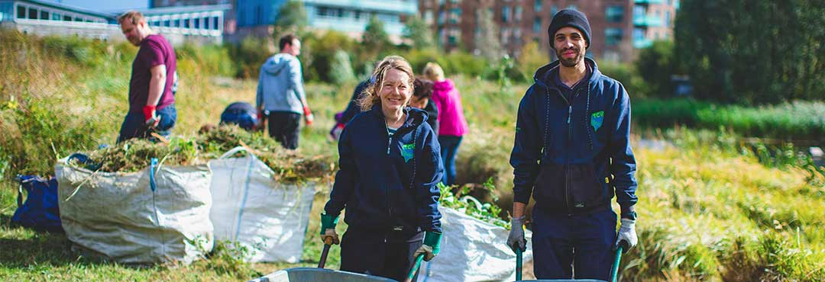
Our Salaries and Benefits
Job Title: Head of Strategic Development (Deputising for the CEO)
Reporting to: Chief Executive Officer
Hours: 28 Hours per week
Salary: Competitive (dependent on experience)
Contract: 2 years (subject to funding)
25 days annual leave pro rata in addition to
bank holidays
A flexible/hybrid scheme
Pension scheme with up to 3% matching employer contribution
The post holder will be entitled to 25 days of annual leave and bank holidays. A flexible hour scheme will operate (subject to the service's demands), and the post holder will be expected to attend occasional evening and weekend meetings.
The post holder will be employed on a 24-month fixed-term contract, subject to a six-month probationary period.

Slide 7
About The Role
Main Purpose of the Role:
To support the Chief Executive Officer in driving forward the strategic vision of Ealing and Hounslow CVS, ensuring the organisation achieves its mission of empowering the voluntary and community sector (VCS). The Head of Strategic Development will be key in strategic planning, stakeholder engagement, programme development and performance management. Acting as a deputy to the CEO, this position requires excellent leadership, analytical, and communication skills to sustain and build partnerships, enhance organisational impact and ensure high-quality service delivery.
Key Responsibilities:
Strategic Planning and Implementation
Collaborate with the Chief Executive Officer to create and implement strategic and operational plans.
Develop and monitor Key Performance Indicators (KPIs) aligned with the organisation’s strategic goals.
Contribute to developing funding proposals and strategic reports for senior leadership and the Board of Trustees.
Lead initiatives to identify and address emerging sector needs. .
Programme and Service Development
Oversee projects and programmes' planning, delivery and evaluation to ensure alignment with organisational objectives.
Ensure quality standards and compliance in service delivery.
Work closely with project leads to develop frameworks for monitoring and evaluation.
Assist in identifying opportunities for innovation and expansion of services.
Stakeholder Engagement and Partnerships
Represent Ealing and Hounslow CVS at high-level meetings and forums.
Maintain and build strategic relationships with key stakeholders, including local authorities, NHS bodies, funders and VCS organisations.
Facilitate two-way communication with partners and stakeholders to strengthen collaboration and influence decision-making.
Lead on stakeholder engagement strategies to enhance the visibility and impact of the organisation.
Work with consortia and joint ventures to align shared goals and objectives, ensuring effective collaboration and partnership outcomes.
Ensure the organisation effectively manages partnerships with subcontractors and consortium members, complying with procurement regulations and maintaining transparency.
Financial and Operational Oversight
Support developing and managing budgets related to strategic initiatives and programmes.
Ensure financial sustainability through effective resource allocation and cost management.
Contribute to internal reviews of policies and procedures, ensuring alignment with organisational goals.

Slide 8
About The Role
Team Leadership and Development
Line manage assigned staff, providing coaching and guidance to achieve their potential.
Foster a collaborative and positive team culture, ensuring alignment with organisational values.
Monitor team performance, celebrate successes and address challenges constructively.
General Duties
Stay abreast of trends and developments within the voluntary and statutory sectors.
Promote the organisation’s vision and mission through effective communication.
Work within organisational policies, including Equality and Diversity, Health & Safety and Data Protection.
Deputise for the CEO when required, ensuring continuity of leadership and decision-making.
Undertake other duties as required by the Chief Executive Officer.

Slide 9
About You
ESSENTIAL
DESIRABLE
Education, qualifications and training | Degree or equivalent experience in a relevant field (Essential). Management qualifications (Desirable).
Experience & Abilities
Skills | Strong strategic planning and analytical skills. Proven ability to manage multiple projects effectively. Excellent communication and influencing skills. Financial literacy, including budget management and analysis. Skilled in partnership building and stakeholder engagement. Proficient in IT systems, including Microsoft Office and database management.
Values and Attributes | Commitment to the values of Ealing and Hounslow CVS. Ability to inspire and motivate teams. Strong interpersonal skills and cultural awareness. Resilient and adaptable in a dynamic environment.
Experience in a leadership or senior management role within the voluntary, public, or private sector.
Proven track record in programme development, implementation, and evaluation.
Demonstrated success in stakeholder engagement and collaboration.
Experience in fundraising or business development.
Understanding the needs and challenges faced by the VCS in Ealing and Hounslow.
Experience working with consortia or managing subcontractor relationships in compliance with procurement standards.

Slide 10
How To Apply
How to Apply:
Interested candidates are invited to complete an application and equal opportunities monitoring form.
Applications should be sent to gurpreet@ehcvs.org.uk by 26th February 2025.
For an informal chat about the role, please email Gurpreet at gurpreet@ehcvs.org.uk to arrange a conversation.

Slide 11

‘The connection between Ealing and Hounslow CVS and the local community/public sector is incredibly valuable; it is efficient and trusted.
There is expertise in supporting and helping our communities that would be difficult to replicate elsewhere.'
EHCVS
First Floor Unit 9 Broads Foundry
Trumpers Way, London, W7 2QP
www.ehcvs.org.uk

