Slide 1







Slide 2

Are you a Black-led community organisation in Ealing dedicated to health and wellbeing?
The Ealing Roots & Wings Grant Programme is here to support your work and amplify your impact.
Why?
Need for greater representation of the African and Caribbean communities in health service decision making.
Need to improving funding for African and Caribbean communities.

Slide 3
What’s included?
✅ £5,000 grant to support your projects
✅ Peer research training for a team member (plus compensation for their time!)
✅ Access to networks and tailored training opportunities
✅ Participation in listening circles to address healthcare challenges

Slide 4
What is peer research training?
“Peer researchers use their lived experience and understanding of a community to help generate information about their peers for research purposes”.
Develop skills to design and lead your own peer research project, tailored to your interests or co-designed with your community or team.
Clarify research objectives, map out fieldwork, and uncover insights that contribute to meaningful, community-led solutions.
How much time will it take?
You will be compensated for up to 106 hours spent on the peer research programme – covering time spent in training sessions, undertaking fieldwork, analysing data, and sharing findings.

Slide 5
Who can apply?
Small community organisations, charities, or voluntary groups with an annual turnover under £200,000
Organisations with at least 50% of board members or leadership who identify as Black ethnicity (African or Caribbean heritage)
Groups delivering activity to improve health and wellbeing - including activity to improve physical health, mental health, social connection, education, employability or financial wellbeing

Slide 6
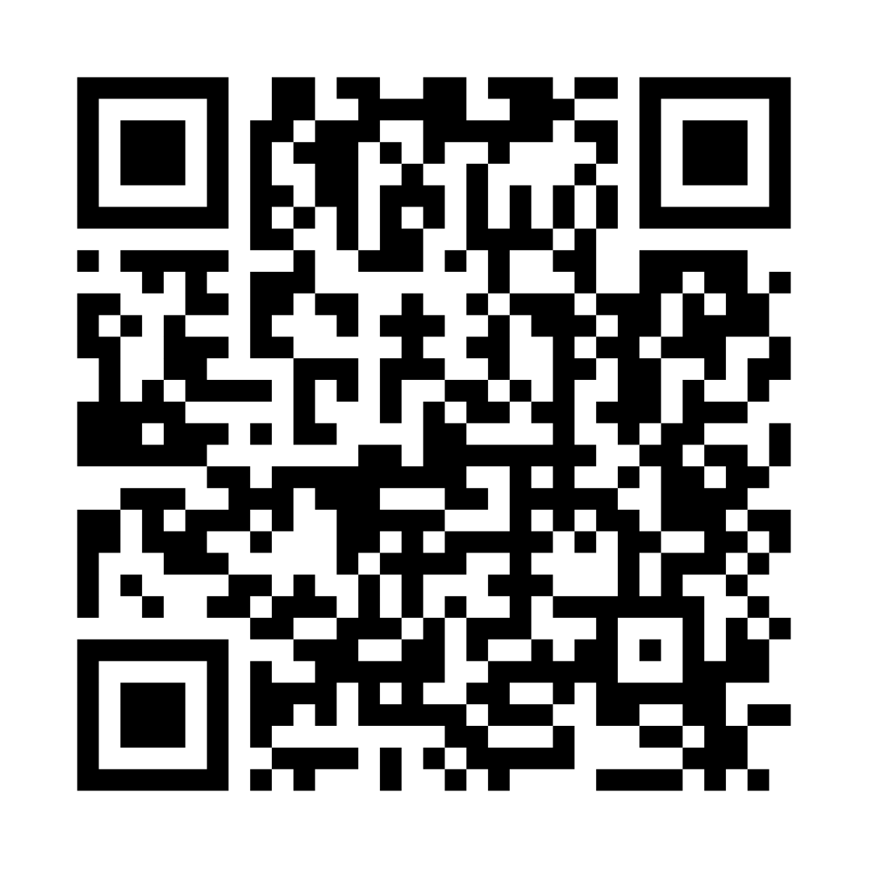
How to apply and further information
Applications open: 2nd December to 20th January
Link to apply: https://ehcvs.org.uk/project/ealing-roots-and-wings/
EHCVS AGM 2nd December
Two information sessions:
  Thursday 5th December 12-1:30pm
  Monday 9th December 1-2:30pm
For queries, please email: development@ehcvs.org.uk

