Slide 1



Bringing free activities, events and opportunities to socially isolated and vulnerable groups across Acton

Slide 2
Agenda
12:10 Introduction and welcome: Liz Baines, EHCVS Community Connections Officer
12:15 Iain Elliott, EHCVS Funding and Group Development Manager
12:20 David Buckley, EHCVS Volunteering and Social Action Officer
12:25 Ana Patricia Izquierdo Suarez, EHCVS Community Care Coordinator
12:30 Shareen Gray, Steel Pan Trust - Director
12:35 Cathy Simeon, UACS - Chair
12:40 MindFood CIC
12:50 Abdi Yassin, Acton Youth Association
12:55 Toyin Ligali, Acton PCN Social Prescriber Referral Management- HIU Project Officer
13:00 – 13:05 Thanks and Close
13:05 – 14:30 Refreshments and Networking

Slide 3
Aims
Reduce social isolation
Improve mental health and wellbeing
Work alongside local people and community groups to encourage people to volunteer and get involved.
Build a caring community
Strengthen social connections and create activities for people to get together and meet others.
Share information about what local services and activities are available.

Slide 4
What will we be doing?
We will be supporting and running FREE activities and special events that run weekly or monthly.
Exercise classes
Special events
Yoga, strength and balance, table tennis, park walks
Arts & crafts, knitting, chess, books, music therapy
Coffee mornings, guest speakers, community projects, special workshops
Hobby clubs

Slide 5
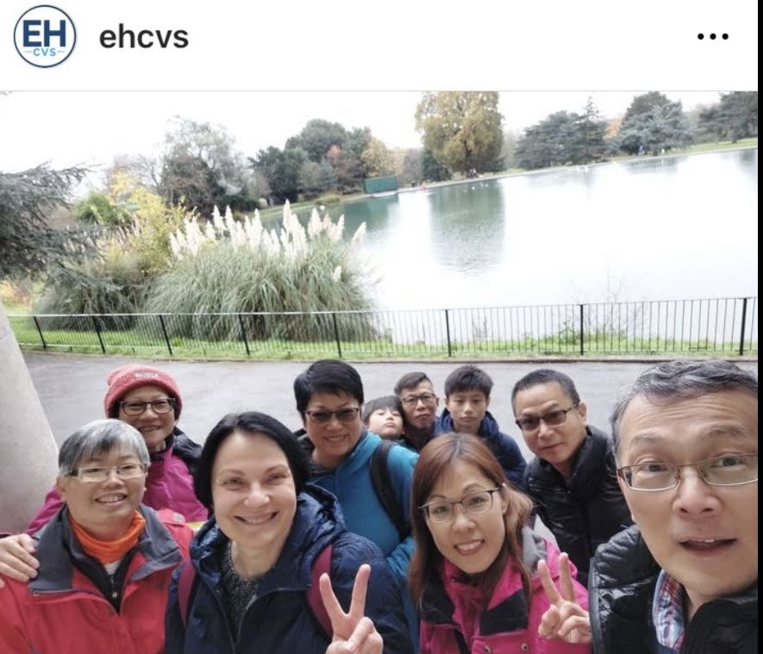
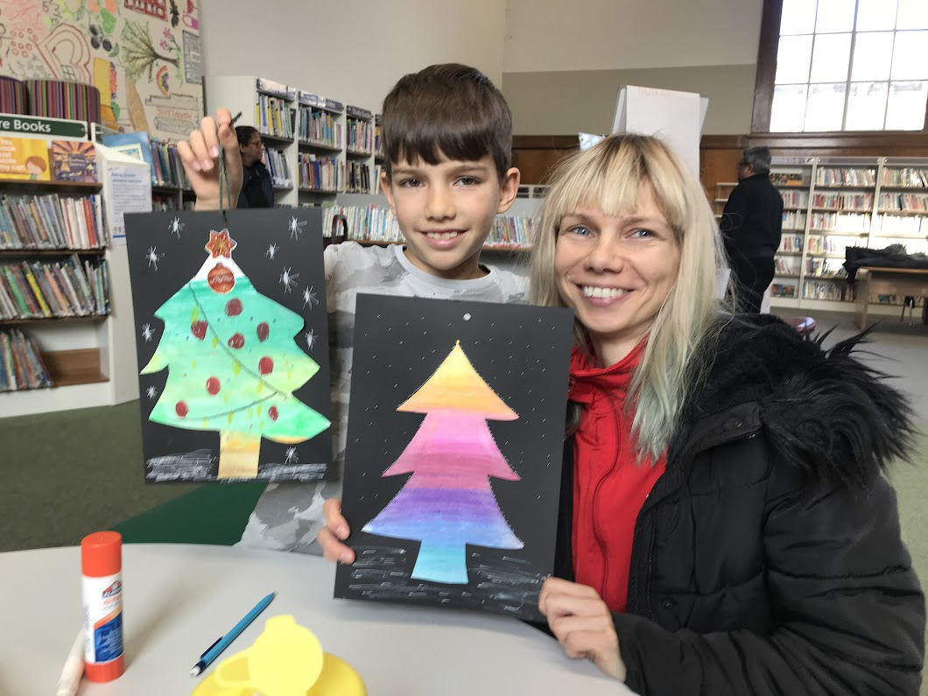
Which groups will we be helping?
Groups supporting older people
Disadvantaged families
Parents and tots
Asylum seekers
New immigrants
English learners
Marginalised groups

Slide 6

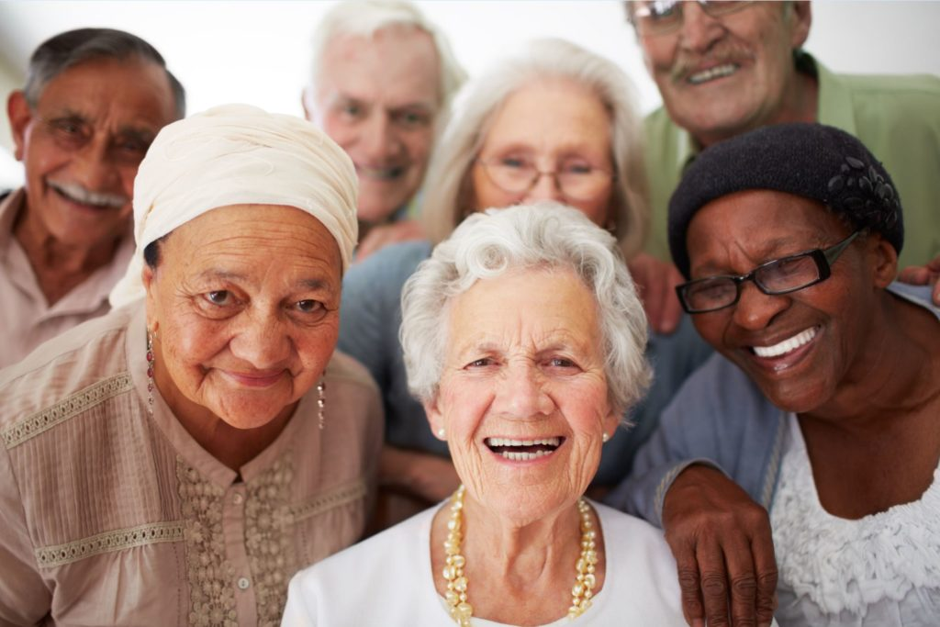


How will we do it?
Local research, visit groups, develop contacts and partnerships, assess feasibility.
Marketing
Promoting Free activities

Slide 7

Marketing/Promoting
Acton Library
Out-reach events
Monthly calendar of events
Word-of-mouth
Newsletter
Volunteers handing out leaflets
Social media
Case studies
Posters in community centres
EHCVS website

Slide 8
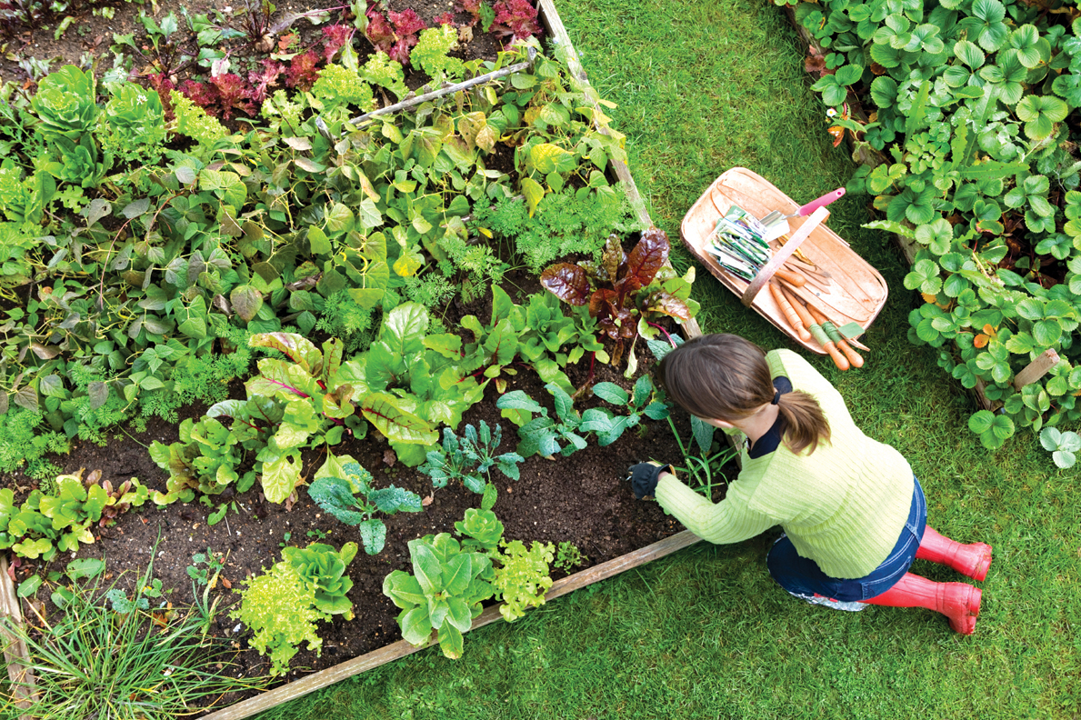
What is ahead?
Exercise activities
Outdoor projects
More guest speakers for vulnerable groups
More encouragement for individuals and groups to volunteer
Engagement with public service departments
Expand network of community groups
This Photo by Unknown Author is licensed under CC BY-SA

Slide 9
Our Partners
EASE
United Anglo Caribbean Society
MindFood CIC
Stay Active 4 Life
Steel Pan Trust
Acton Youth Association

Slide 10
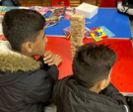
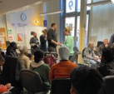
EASE Ealing and Acton Support Enterprise
A local charity enabling asylum seekers and refugees to thrive
Drop-in Thursday
Asylum seekers
New immigrants
English learners

Slide 11
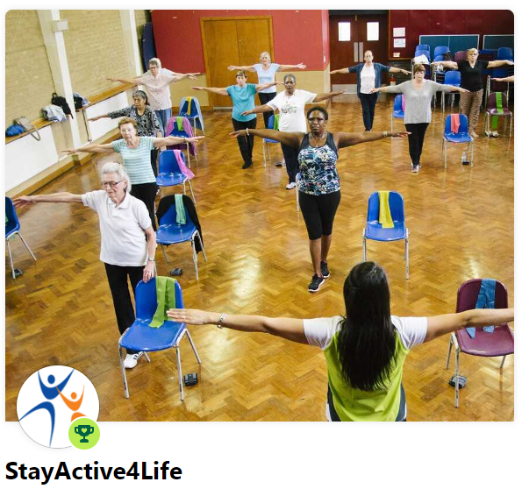
STAYACTIVE4LIFE
Varied exercise classes, which have been praised for improving balance, strength, and overall fitness
Strengthen your muscles and become more flexible
Maintain your balance so that you feel steady on your feet and reduce your risk of falls
Have greater stamina and more energy so that you can live your life to the full
Maintaining and building muscle strength and balance is crucial in helping people stay mobile and independent as they get older, reduce their risk of falls and help them keep doing the daily activities that are important to them

Slide 12
Thank you!
Ealing Council
Libraries, community centres, churches
Residents, small groups, and local charities
Volunteers
EHCVS staff
Collaboration is key

