Slide 1
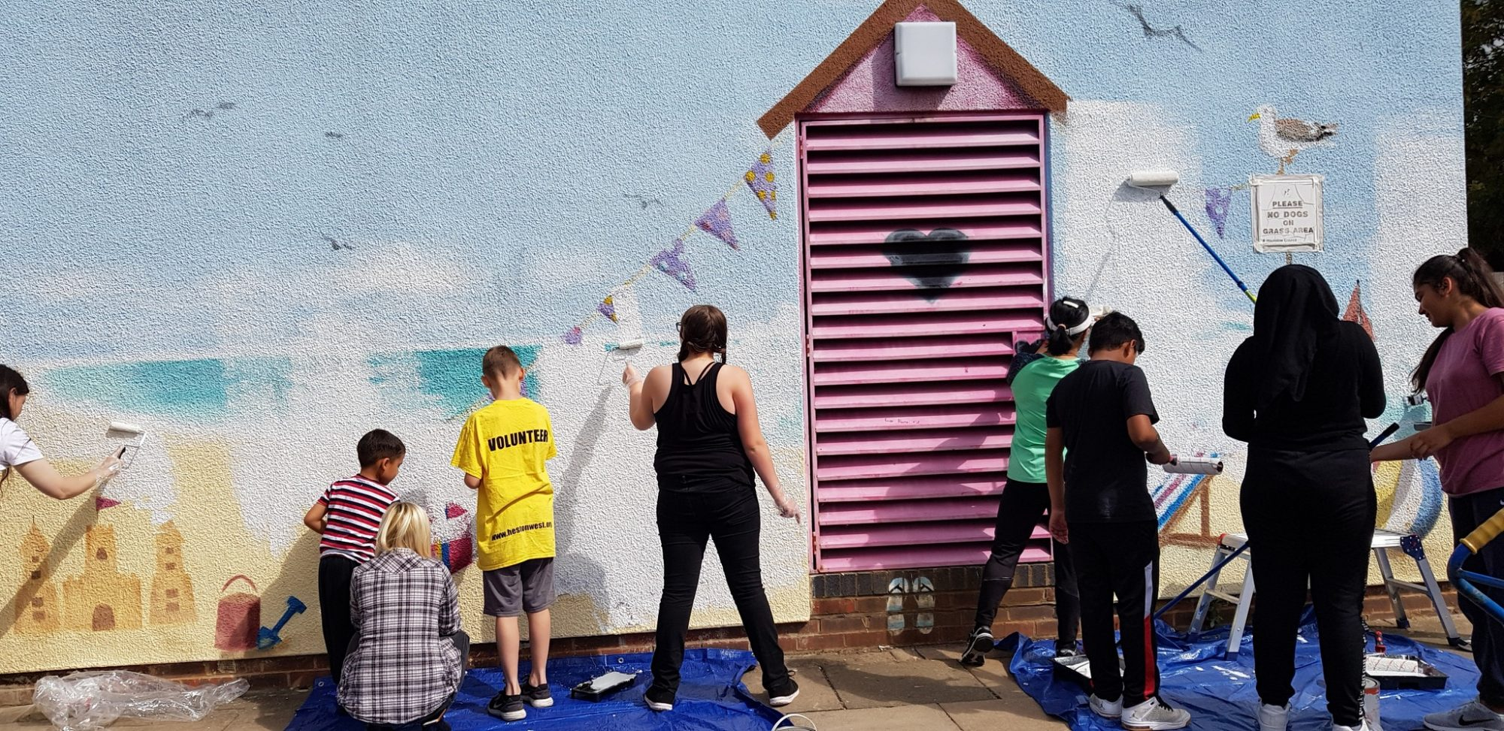

Recruitment Pack
ActForEaling Hub Manager
‘ The team at Ealing CVS are incredibly knowledgeable and always keen to support and connect local groups. Their insight into the ever changing landscape of third sector funding has been invaluable. It has enabled new groups in Ealing and Hounslow to emerge and established ones to continue supporting the local community’
EHCVS

Slide 2
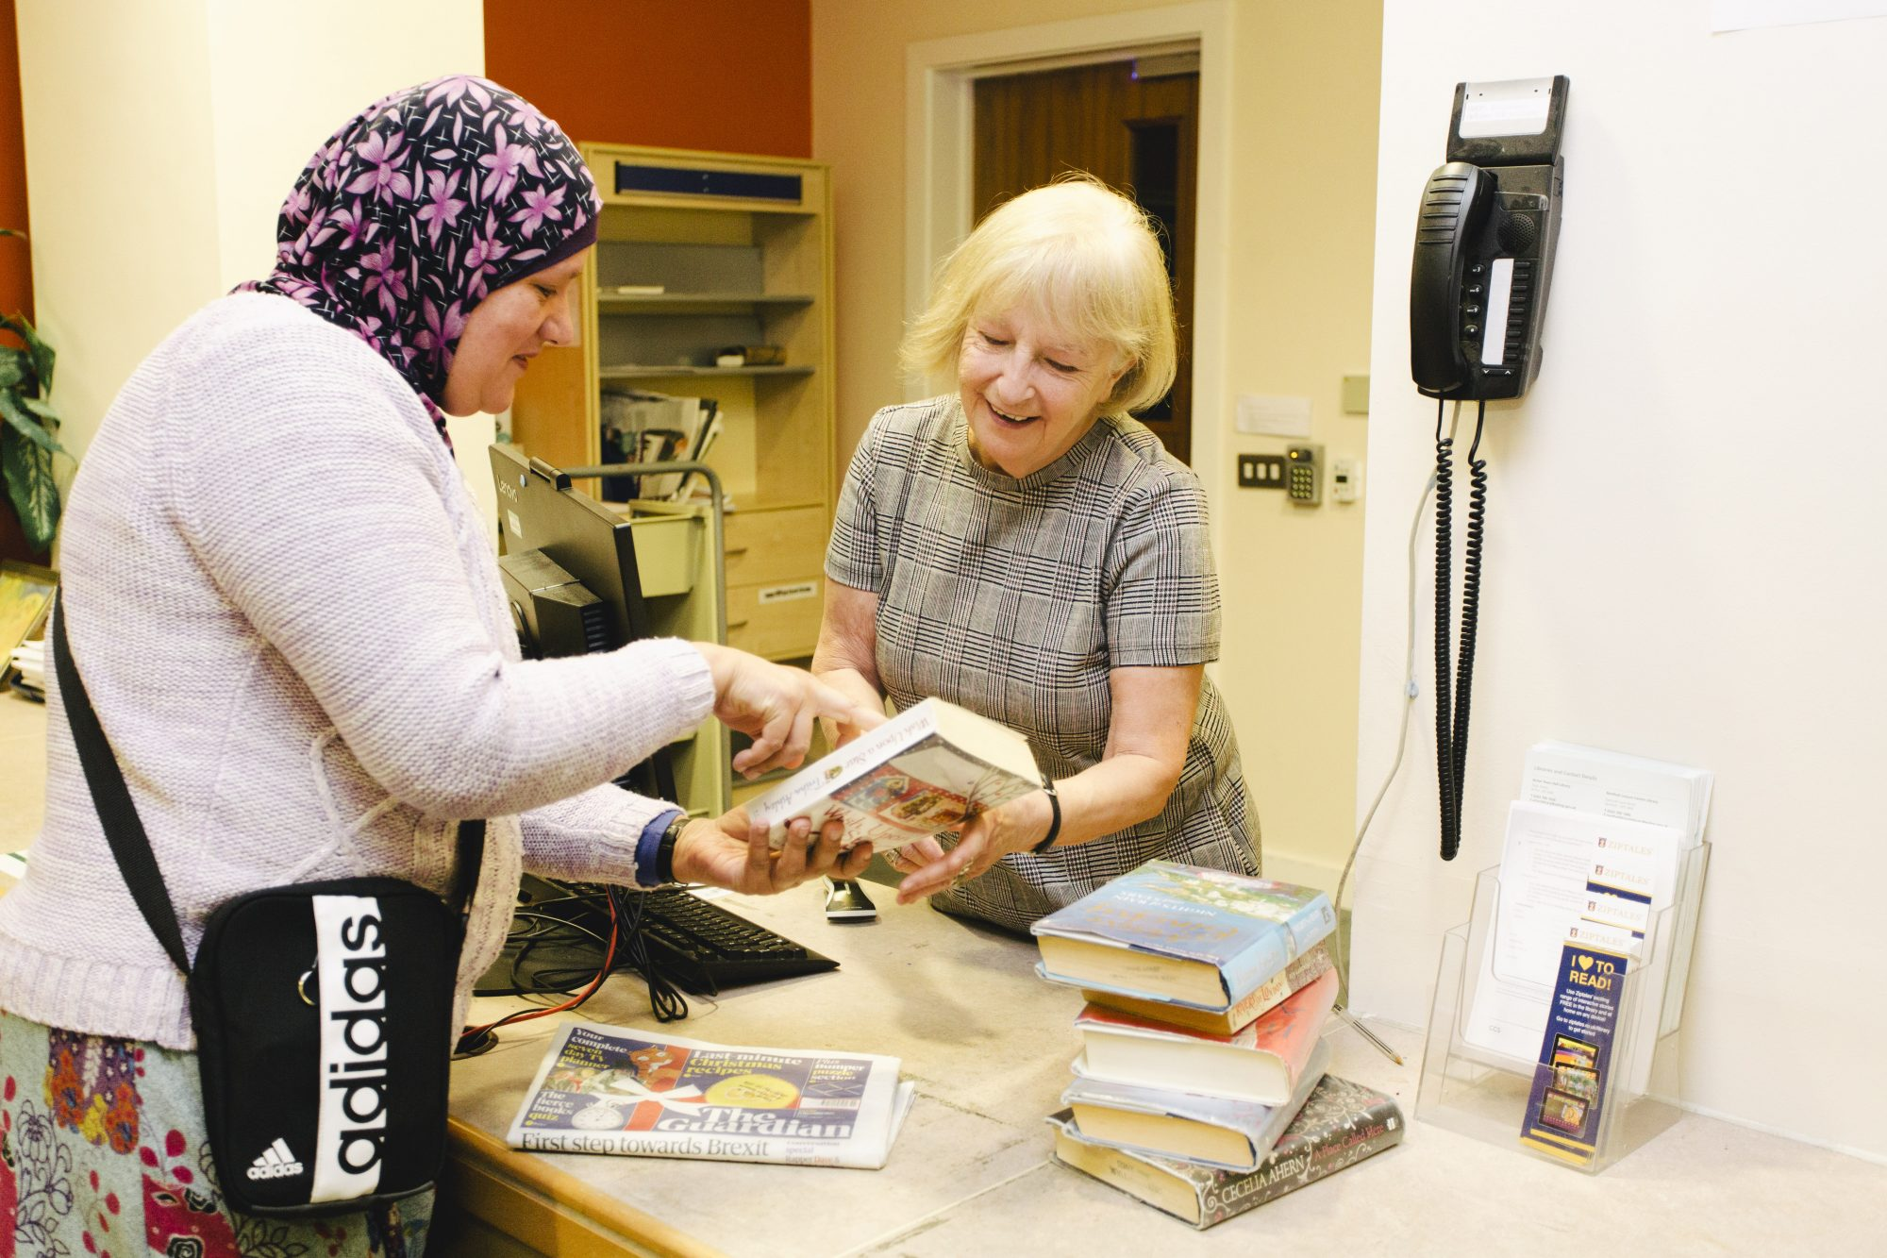

About Ealing &
Hounslow CVS
Ealing and Hounslow Community Voluntary Service is a registered local charity that has been supporting voluntary and community sector (VCS) groups in Ealing for over 30 years and Hounslow groups since 2012.
In this rapidly changing world where our sector continues to face many challenges and take on new opportunities, it is highly appropriate that Ealing CVS has undertaken a process of reviewing and planning for the next three years. Consulting with our stakeholders has been a refreshing process, and has provided us with an opportunity to study how well we delivered our core themes from our latest Business Plan – developing, connecting, representing and innovating with the third sector in Ealing and Hounslow - and to establish new and more relevant themes of work for future delivery.
Ealing CVS is a second-tier organisation that works with local charities and voluntary organisations in Ealing and Hounslow. The overall aim is to provide a professional and effective service to local voluntary organisations through assistance and through forming consortia and bidding for major tranches of funding aimed at improving the lives of the local communities.

Slide 3
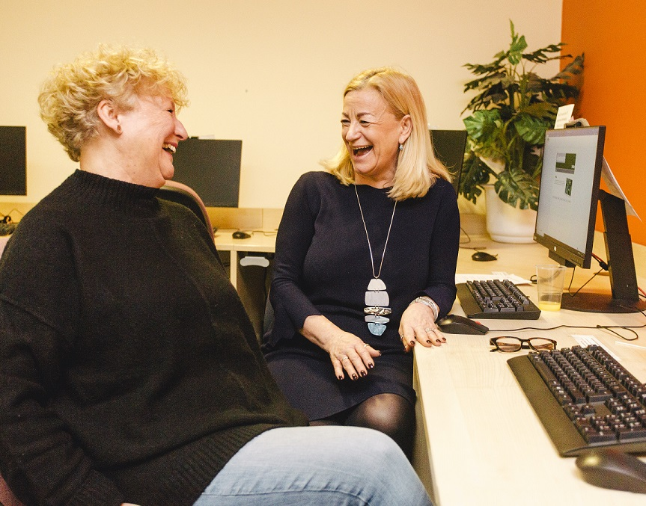

About Us
We are currently a team of 10 with a diverse range of backgrounds and skill sets. To find out more about us and read more about each member of our team.
You can find out more about our Trustees here too

Slide 4
Our Aims and Values
EHCVS’s aim is to deliver an improved quality of life for the less advantaged people in Ealing, Hounslow and surrounding areas. We do this through:
Assisting local charities and volunteer organisations to operate more effectively.
Working with partners in undertaking projects.
Undertaking projects directly.
Our promises to our funders are to:
Work to achieve the agreed deliverables within the proposed timescales and costs;
Where problems or concerns may arise to advise the funder at the earliest practical time and to work with them to obtain a mutually satisfactory resolution;
Where we are working directly with local people to ensure that we obtain adequate feedback on their satisfaction with the service we are offering.
Our promises to our staff are to:
Help them to work together in a constructive manner to achieve our agreed deliverables;
Ensure that their progress on projects can be tracked and assistance provided at the earliest opportunity to overcome any problems and concerns that may arise.
Develop their skills and opportunities to take on different types of work.
Overall it is the aim of EHCVS to be the most efficient and effective provider of these community services in London.

Slide 5
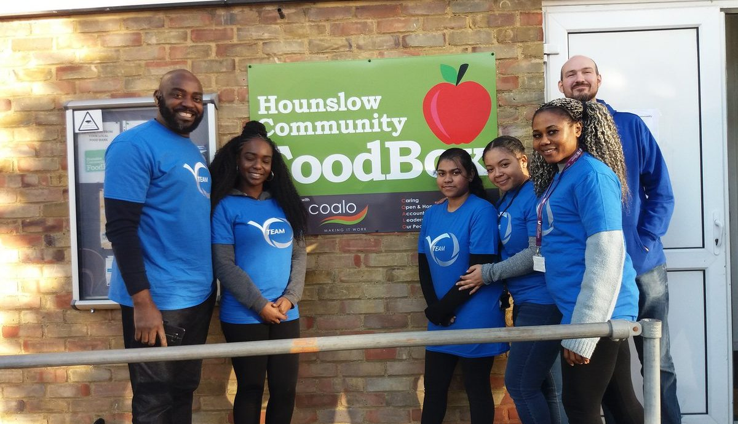
Our Strategic Objectives
Ealing and Hounslow CVS has big plans and to achieve these we recognise that we may need to make changes and consider new ways of working. A core principle of our work has been, and continues to be, partnerships. We want to work with people, organisations and businesses that want to build, inspire, develop and enable our communities and volunteers to make a difference locally.
We expect to work with partners across statutory, private and third sectors and want to build the engagement and involvement that is key to our success. We want to work collectively and to challenge the current ways of working and develop novel solutions to address emerging needs. An important part of the culture at Ealing CVS is listening and we will continue to conduct surveys, host forums, facilitate cross-networking and develop local mechanisms to enable this and to facilitate the sharing of services and information.

Slide 6

Our Salaries and Benefits
28 days annual leave pro rata in addition to bank holidays
A flexible hour’s scheme
Time off in lieu of additional hours worked
Pension scheme with up to 3% matching employer contribution
The postholder will be employed for 28 hours per week.
The postholder will be entitled to 28 days annual leave pro rata in addition to 8 bank holidays. A flexible hour’s scheme will operate (subject to the demands of the service) and the postholder will be expected to attend occasional evening and weekend meetings. Time off in lieu of additional hours will be offered for any additional hours worked.
The postholder will be employed on a 12-month fixed-term contract.
The post is subject to a three-month probationary period. EHCVS offers staff access to a stakeholder pension scheme with up to 3% matching employer contribution following successful completion of the probationary period.

Slide 7
About The Role
Act For Ealing Hub Manager
West London – Ealing
£35,000 Pro Rate
28 hours per week, in the office or local outreach locations, combination remote working
PURPOSE OF THE POST
ActForEaling’s purpose is to facilitate the engagement of the community of Ealing in meaningful and effective action to address the Climate and Ecological Emergency. This will support Ealing Council's net zero by 2030 target.
MAIN DUTIES AND RESPONSIBILITIES
ActForEaling Hub Manager
The ActForEaling Hub Manager is an essential role for the group. Their responsibilities are to activate the partnership network and steering group to realise the Purpose lead the delivery of the annual work plan. Generally, the Hub Manager will be responsible for:
Partnership development
engage and facilitate participation of key Ealing based environmental community groups (as identified with the Steering Group) with ActForEaling
contact, develop and maintain working relationships with the wide range of community groups and entities across Ealing to engage their support and participation in the purpose of ActForEaling.
ensure the range of local groups contacted and engaged are drawn from faith, age and community backgrounds that reflect the demographic make-up of Ealing borough.
engage with schools and youth groups to facilitate participation 0n the project.
create and maintain a database of all groups engaged and contacted through the process of this project.
Engagement
organise and hold four or more ActForEaling events in the 12-month period to engage with members of the public and publicise the ActForEaling programme and climate and sustainability activities in the borough.
manage the project’s website, updating content and connectivity.
manage the project’s Facebook pages, curating and managing content, posts and access
manage all social media relating to the project.
create a regular newsletter for distribution to ActForEaling members.
monitor member activity to create case studies to showcase member success.

Slide 8
About The Role
MONITORING AND ADMINISTRATION
communicate regularly and effectively with the designated manager within EHCVS, the employing agency.
help recruit and work closely with the ActForEaling Steering Group who will have overall authority for the direction and functioning of ActForEaling. The work of this post will be accountable to the Steering Group.
arrange and chair the bi-weekly partner meetings including circulation of agendas and papers and meeting minutes.
maintain appropriate flows of information with and between the steering group and contributing members.
monitor impact at a granular and annual level, through the collection of data points (i.e., surveys, digital engagement statistics, headcount, etc)
OTHER DUTIES
Assist in producing briefings, information, and web material.
Assist in producing monitoring and evaluation information
Assist in developing and organising events
Represent Ealing & Hounslow CVS at meetings and events relevant to your project.
Undertake other related project duties as may be required
To work in co-operation with other members of the staff team of EHCVS, attend appropriate internal and external meetings.
Support EHCVS with other project developments and funding applications to funders.
To undertake, as identified by EHCVS’s Board of Trustees any occasional additional duties commensurate with the responsibilities of the post which may not be purely related to this role.
MONITORING AND EVALUATION
To record monitoring information; review progress of current projects on a weekly basis and manage upwards.
Prepare written evaluation reports for EHCVS, projects and services.
Support the Funding and Partnerships manager and Development Services Manager with monitoring information collated from service as and when required, Weekly and monthly reporting.
CORPORATE RESPONSIBILITIES
To ensure that Equal Opportunities and all other EHCVS organisational policies are actively implemented and adhered to in all areas of your work.
To work with EHCVS staff and volunteers towards the effective achievement of the organisation’s objectives.
To ensure all volunteers working with you are given appropriate induction and to provide information and support for all volunteers working for EHCVS
MANAGEMENT AND SUPPORT
The postholder will be employed by Ealing & Hounslow CVS and supervised and managed by the Senior Development Services Manager. The postholder will participate in monthly supervision with their line manager as well as a weekly team meeting and organisation-wide staff meetings. An individual induction and training plan will be agreed on.

Slide 9
About You
ESSENTIAL
DESIRABLE
Education & Qualifications | Demonstrable experience of the fundraising sector and successful fundraising record
Experience & Abilities | Experience of working with voluntary/community organisations, and social enterprises Understanding of voluntary and community sector ‘umbrella’ organisations and their support role Action planning and supporting groups to achieve goals Setting up steering groups, forums, or networks Experience in monitoring and evaluating Excellent verbal and written communication skills Excellent organisational and interpersonal skills. Close attention to detail at all times – particularly in relation to data management and confidentiality. Highly skilled at communicating effectively with a wide range of stakeholders, in person and in writing. The ability to think strategically, come up with practical solutions and to juggle a varied workload. Understanding of and preparedness to work within the objectives of EHCVS Experience of working with the range of organisations and services Knowledge of organisational development issues within the voluntary sector A knowledge of monitoring, reviewing, and evaluating projects; and demonstrating impact An understanding of and commitment to equal opportunities policies and a commitment to implementing them in all aspects of the post | Knowledge of the range of organisations services and activities available to the project.
Skills Analytical/ Judgmental Planning & Organising Communication | Ability to problem solve and to prioritise competing demands of the role for the benefit of service users An ability to work collaboratively as part of the EHCVS team and with other groups and agencies Ability to speak at meetings, make presentations and write reports Ability to prioritise conflicting work demands Ability to deliver or willingness (with training) to be able to deliver training courses The ability to plan and manage own work and to take initiative to improve wider services on offer. Strong organisational skills Proficiency in all Office programmes.
Personal Qualities Interpersonal skills Team/Collaborative working - Flexibility | To be able to contribute to team decisions and strategic thinking Ability to work within a team with a range of experience and knowledge of fundraising Willingness to work occasional weekends and evenings Understanding of the Ealing and Hounslow Voluntary Sector Experience of cross sector partnership working and delivering partnership projects Experience of working with the voluntary and community sector Experience of working with the statutory sector; local authority and NHS Willingness to engage in training and development opportunities Knowledge of database management

Slide 10
How To Apply
Please note, this is not a working for home opportunity.
Application deadline: 17.00 (GMT), Thursday 16 June 2022
This is a front-line role. The post holder will work across Ealing
Interviews will take place during the week beginning Monday 27th June 2022 (In Person)
To apply, please email you CV to irfan@ehcvs.org.uk
Please also include two professional references. References will only be contacted if an offer has been made.
Please also complete an Equality Monitoring form, which can be downloaded here
We can only give feedback to candidates who are shortlisted
ELIGIBILITY
Applicants must be eligible to work in the United Kingdom (UK) and provide information regarding the basis of their right to work in the UK with their application

Slide 11

‘The connection between Ealing and Hounslow CVS and the local community/public sector is incredibly valuable. It is efficient and trusted. There is expertise that is supporting and helping our communities that would be difficult to replicate elsewhere’.
EHCVS
Ealing and Hounslow CVS, West Ealing Library,
Melbourne Avenue, West Ealing W13 9BT
www.ehcvs.org.uk

