Slide 1

Hounslow Resident Engagement Project
Mental Health & Wellbeing Group
23rd March 2022 14.30-16.00

Slide 2
Agenda
Welcome (5 minutes)
Sunflower Project (10 minutes)
Resident Engagement Project (5 minutes)
Collaborate session – Questions and Feedback (45 minutes)
How to apply for the Engagement Small Grant (10 minutes)
Q&A
Project updates
AOB

Slide 3

Sunflower Project

Slide 4

Sunflower Project
VCSE
Council
Health
Commonalities at the heart of Sunflower:
People centred/empower residents
Preventative approach/invest in prevention
Partnership with the VCSE

Slide 5

Sunflower Project
What are we trying to prevent/minimise impact of?
In order to prevent unnecessary use of statutory provision especially:
Hospitals
Packages of Social Care/Care Homes
Homelessness etc……
….which are bad outcomes for our people and expensive for the system
Falls
Long Term Health Condition esp. Diabetes, Respiratory, CVD
Mental Health
Dementia
Learning Disabilities
Social Isolation and Loneliness
Alcohol and Substance Minuses
Obesity
Through early support VCSE provision to keep people well, happy and in their own homes

Slide 6

Sunflower Project
Key Objectives:
Supporting residents to remain independent and live well in the community
Building a preventative community and promoting self-care
Enhancing the role and relationship with the voluntary sector
Leveraging in health money and focus in an integrated approach with the voluntary sector to deliver prevention outcomes
Utilising potential of volunteers and peer support
Reducing health and social inequalities

Slide 7
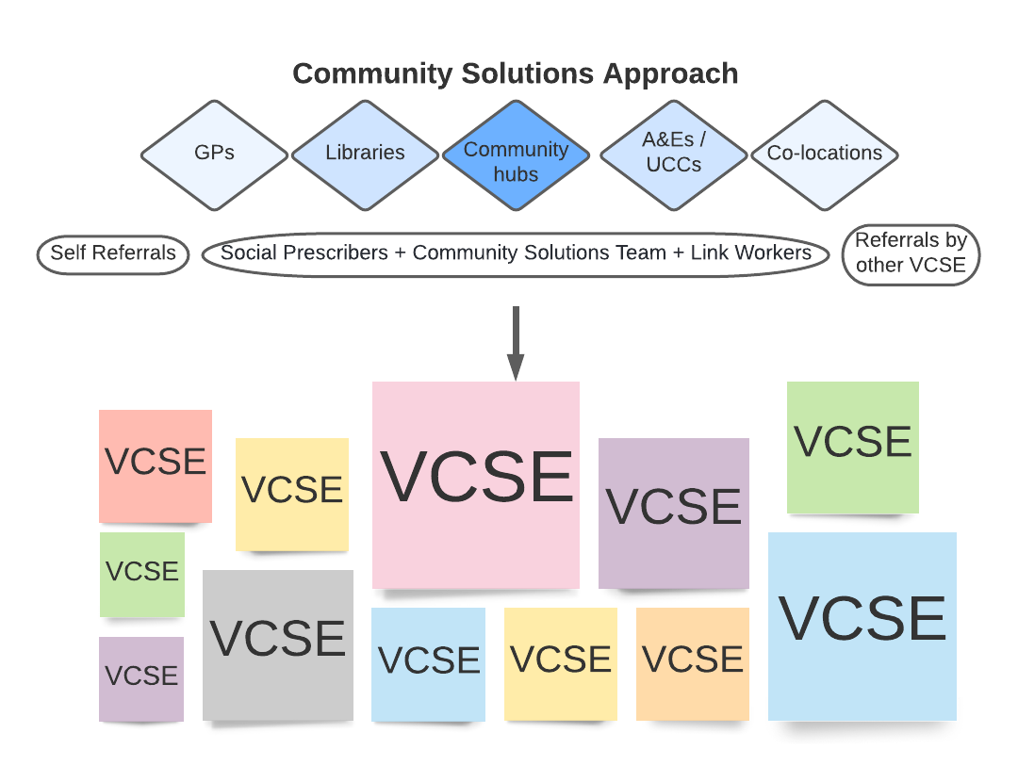
Sunflower Project

Slide 8
Sunflower Project
Delivery Model
How? Who? Where?
Contracts
Community Development (e.g. volunteering and self care groups)
Grants
Joint funded grants pot
Where residents choose e.g.:
Home
Support Workers
Libraries
Volunteers / Befrienders / Buddies
Parks & open spaces
Peer Support / Expert Patients
Other community hubs
Digital

Slide 9
Sunflower Project
In Scope
MINT Grants £200K
MINT Grants for Young People £72K
The CCG are funding £50K for VCSE grants towards ICP Priorities
WLT Wellbeing Network provision moving into the VCSE
Plans for WLT Forensic grants
Hestia and other VCSE Community Contracts
The Sunflower vision is to commission for an even more vibrant VCSE offer and work together in partnership to deliver on the Community Solutions agenda incorporating Health agendas
(Integrated Care Partnership, MINT, and Social Prescribing)

Slide 10
Resident Engagement Project through VCSE Partnership
Aims
To bring residents, active users of community groups and the voluntary sector into shaping the Sunflower Project and other preventative health and wellbeing services in Hounslow.
This will ensure our services are:
Inclusive and representative of the diverse needs of local population
Targeted and suited better, resulting in better outcomes in preventative intervention
Reaching those that we traditionally have less interaction with
Objectives
To identify the main areas of unmet need currently and how they could be addressed
To identify services, activities and approaches that work well and could be expanded
To identify barriers and how to overcome them

Slide 11
Resident Engagement Project through VCSE Partnership
Questions we plan to ask our residents
What would help you to live as well as you can?
What difficulties do you face at the present that affect your wellbeing? (E.g., health conditions / mental health / money / where you live / feeling isolated / not getting help)
What would help with these difficulties? Are there activities you could do or advice and support that you could receive that would make a difference? (E.g., exercise classes / peer support / wellbeing groups / practical help with issues / skills & learning / helping you to travel / going to activities with you / culturally sensitive activities)
Are you already doing any of these activities or receiving any advice and support? If yes which ones?
If you are not, what is stopping you?
But are these the right questions? We need you to tell us!

Slide 12

Resident Engagement Project through VCSE Partnership
What do you think…?
Please use the ‘raise hand ’ function and we will invite you to unmute and speak. Alternatively you can also give comments using the chat function.
Please introduce yourself and your organisation ☺
Discussion Question 1:
Think about the questions that we just showed you, are they the right questions to ask our residents? How can we ask these questions in a better way? Any other questions you want to add?

Slide 13
Resident Engagement Project through VCSE Partnership
What do you think…?
Please use the ‘raise hand ’ function and we will invite you to unmute and speak. Alternatively you can also give comments using the chat function.
Please introduce yourself and your organisation ☺
Discussion Question 2:
If you were to engage with your communities or people you support, how would you go about getting responses to the questions we asked? (E.g., interviews, surveys, groups, …)

Slide 14
Resident Engagement Project through VCSE Partnership
What do you think…?
Please use the ‘raise hand ’ function and we will invite you to unmute and speak. Alternatively you can also give comments using the chat function.
Please introduce yourself and your organisation ☺
Discussion Question 3:
What is stopping people from accessing services or going to groups in the community?

Slide 15
Resident Engagement Project through VCSE Partnership
What do you think…?
Please use the ‘raise hand ’ function and we will invite you to unmute and speak. Alternatively you can also give comments using the chat function.
Please introduce yourself and your organisation ☺
Discussion Question 4:
Think about the activities/services in the community (non-council/non-NHS services), what are some of the good ones that you want to see more of? What is missing?

Slide 16
Engagement Small Grant
Aim of grant:
Support local VCS organisations/groups to engage with the members of your communities or the people you support, to understand what would help to improve their wellbeing and what barriers they are facing. The feedback collected will be used to inform the design and development of the Sunflower Project and other preventative health & wellbeing services in the community.
Costs of engagement activities can be funded through the grant, which may include (not limited to):
Staffing | Activity costs (e.g., refreshment, stationery) | Administration
Venue hire | Travel costs (staff, volunteers, residents) | Incentives for engagement
Who can apply:
Voluntary and community sector (VCS) organisation, or resident groups including informal groups.
Amount available:
Up to £4,000 for each organisation or group.

Slide 17
Engagement Small Grant
Timeline
Engagement activities
+
Collating the feedback collected
(6 weeks)
Expression of Interest (EOI Form)
Small grant application (3 weeks) and grant award
Reporting back on outcome of engagement
Shortlisting (if needed) and invitation to apply for small grant
Project Initiation Workshop and optional one-to-one sessions
By Friday
1st April 2022
By Friday
29th April 2022
Mid May to
end of June
By Friday
8th April 2022
After Friday
13th May 2022
By Friday
1st July 2022

Slide 18
Engagement Small Grant
Key dates
Date | Activity
Friday 1st April 2022 at 5pm | Deadline for Expression of Interest (EOI)
By Friday 8th April 2022 | Invitation to apply for small grant (email/phone)
Friday 29th April 2022 at 5pm | Deadline for small grant application
By Friday 13th May 2022 | Notification of small grant application result
By Friday 1st July 2022 | Submission of engagement outcome report
Slides, recording and the Expression of Interest Form will be shared with all attendees of this meeting. To obtain a copy of the Expression of Interest Form, or for further information, please email: Hannah Tang (Assistant Joint Commissioning Manager) at LifeProject@hounslow.gov.uk

