Slide 1
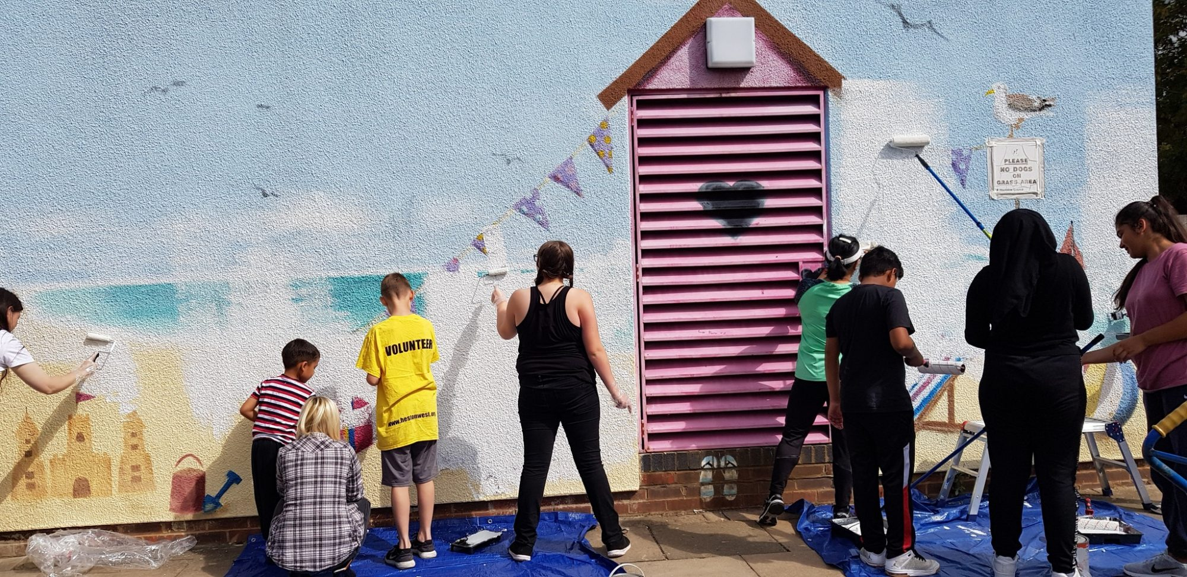

Recruitment Pack
Fundraising and Partnerships Manager
‘ The team at Ealing CVS are incredibly knowledgeable and always keen to support and connect local groups. Their insight into the ever changing landscape of third sector funding has been invaluable. It has enabled new groups in Ealing and Hounslow to emerge and established ones to continue supporting the local community’
EHCVS

Slide 2
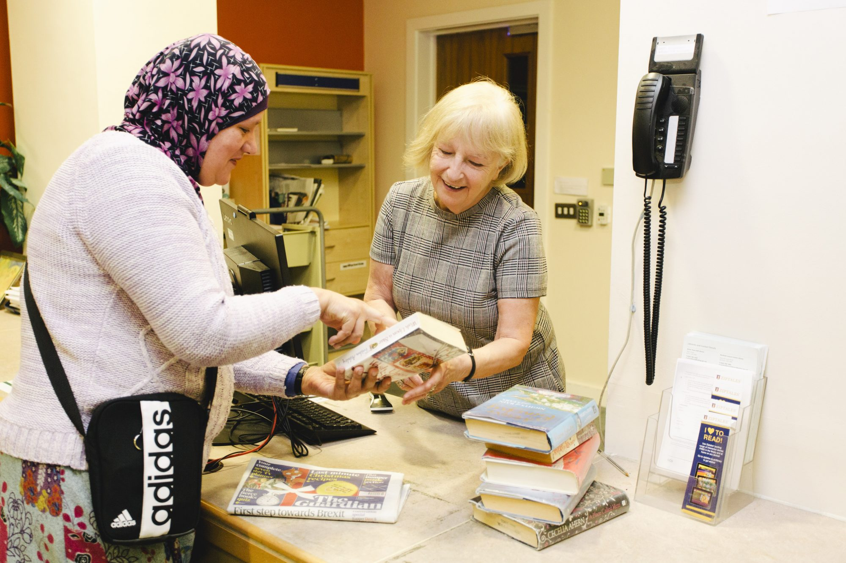

About Ealing &
Hounslow CVS
Ealing and Hounslow Community Voluntary Service is a registered local charity that has been supporting voluntary and community sector (VCS) groups in Ealing for over 30 years and Hounslow groups since 2012.
In this rapidly changing world where our sector continues to face many challenges and take on new opportunities, it is highly appropriate that Ealing CVS has undertaken a process of reviewing and planning for the next three years. Consulting with our stakeholders has been a refreshing process, and has provided us with an opportunity to study how well we delivered our core themes from our latest Business Plan – developing, connecting, representing and innovating with the third sector in Ealing and Hounslow - and to establish new and more relevant themes of work for future delivery.
Ealing CVS is a second-tier organisation that works with local charities and voluntary organisations in Ealing and Hounslow. The overall aim is to provide a professional and effective service to local voluntary organisations through assistance and through forming consortia and bidding for major tranches of funding aimed at improving the lives of the local communities.

Slide 3
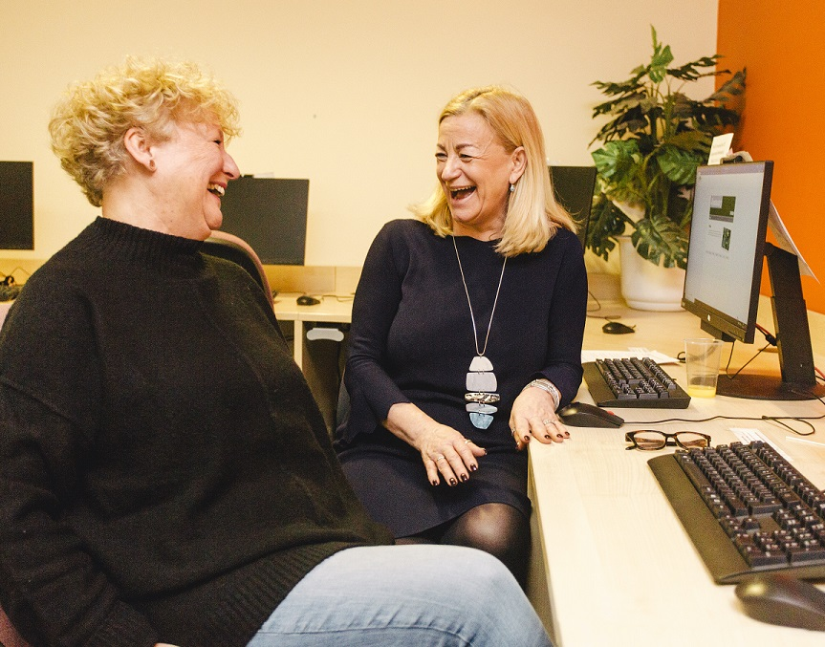

About Us
We are currently a team of 10 with a diverse range of backgrounds and skill sets. To find out more about us and read more about each member of our team.
You can find out more about our Trustees here too

Slide 4
Our Aims and Values
EHCVS’s aim is to deliver an improved quality of life for the less advantaged people in Ealing, Hounslow and surrounding areas. We do this through:
Assisting local charities and volunteer organisations to operate more effectively.
Working with partners in undertaking projects.
Undertaking projects directly.
Our promises to our funders are to:
Work to achieve the agreed deliverables within the proposed timescales and costs;
Where problems or concerns may arise to advise the funder at the earliest practical time and to work with them to obtain a mutually satisfactory resolution;
Where we are working directly with local people to ensure that we obtain adequate feedback on their satisfaction with the service we are offering.
Our promises to our staff are to:
Help them to work together in a constructive manner to achieve our agreed deliverables;
Ensure that their progress on projects can be tracked and assistance provided at the earliest opportunity to overcome any problems and concerns that may arise.
Develop their skills and opportunities to take on different types of work.
Overall it is the aim of EHCVS to be the most efficient and effective provider of these community services in London.

Slide 5
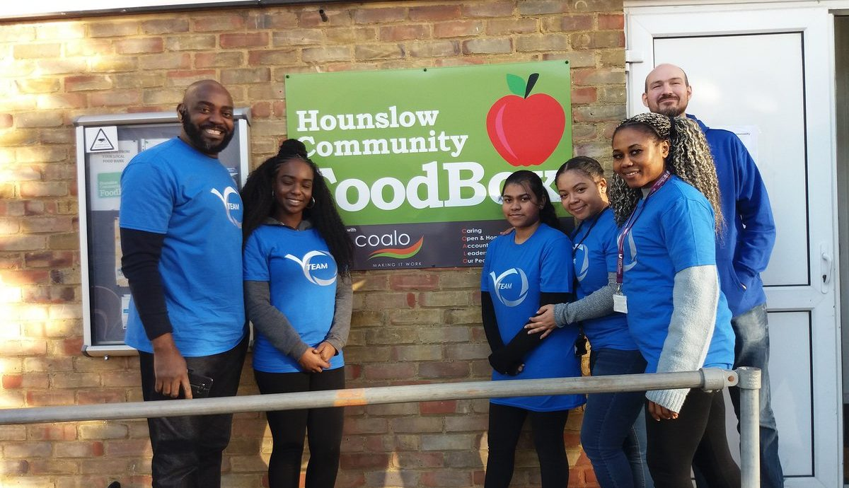
Our Strategic Objectives
Ealing and Hounslow CVS has big plans and to achieve these we recognise that we may need to make changes and consider new ways of working. A core principle of our work has been, and continues to be, partnerships. We want to work with people, organisations and businesses that want to build, inspire, develop and enable our communities and volunteers to make a difference locally.
We expect to work with partners across statutory, private and third sectors and want to build the engagement and involvement that is key to our success. We want to work collectively and to challenge the current ways of working and develop novel solutions to address emerging needs. An important part of the culture at Ealing CVS is listening and we will continue to conduct surveys, host forums, facilitate cross-networking and develop local mechanisms to enable this and to facilitate the sharing of services and information.

Slide 6
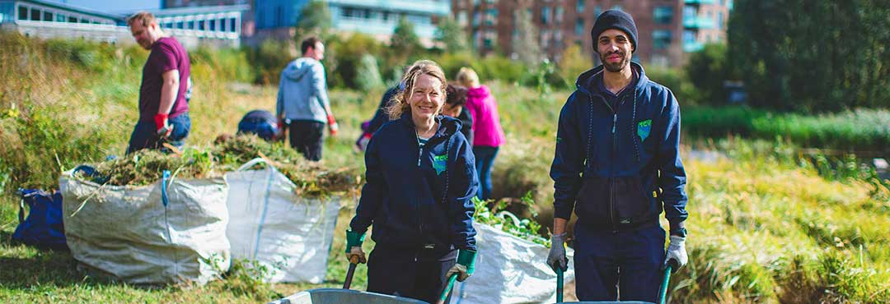
Our Salaries and Benefits
25 days annual leave pro rata in addition to bank holidays
A flexible hour’s scheme
Time off in lieu of additional hours worked
Pension scheme with up to 3% matching employer contribution
The postholder will be employed for 21 hours per week.
The postholder will be entitled to 25 days annual leave pro rata in addition to bank holidays. A flexible hour’s scheme will operate (subject to the demands of the service) and the postholder will be expected to attend occasional evening and weekend meetings. Time off in lieu of additional hours will be offered for any additional hours worked.
The postholder will be employed on a 12-month fixed-term contract.
The post is subject to a three-month probationary period. EHCVS offers staff access to a stakeholder pension scheme with up to 3% matching employer contribution following successful completion of the probationary period.

Slide 7
About The Role
Fundraising and Partnerships Manager
Ealing, Greater London
Salary Commensurate with the responsibilities of the post
Part-time, 21 hours per week, 12-month fixed term contract
PURPOSE OF THE POST
The Fundraising and Partnerships Manager is responsible for managing Ealing and Hounslow funding and development activities – identifying and developing funding opportunities, responding to proposals, and building new programme partnerships.
Supporting the CEO and senior management team to develop an effective and successful fundraising strategy.
MAIN DUTIES AND RESPONSIBILITIES
Developing new partnerships
Creating new partnerships with employers, sector bodies, trusts, and foundations, enabling us to work together to further essential skills development.
Working closely with voluntary sector partners to map out their needs and identify funding to meet their needs.
Creating bespoke partnership proposals to support partners.
Working closely with the Senior Development Services Manager to ensure the delivery of partnership activities and bespoke support to each key partner.
Establish relationships with local groups and charitable organisations with a view to submit joint bids for projects that support similar objectives and/or potential to leverage higher levels of funding.
Managing existing partnerships
Maintaining and developing relationships with our existing partners by acting as the account manager for key relationships with employers, infrastructure bodies (Local Authorities, sector bodies, membership organisations), trusts and foundations.
Communicating effectively with partners and evolving their engagement with us by identifying new opportunities for them to embed meaningful essential skills development within their work.
Reporting to partners on the impact of their work with us and providing stewardship activities to connect them with the impact.

Slide 8
About The Role
Fundraising
Having strategic responsibility for the income pipeline relating to innovation projects and core organisational costs. This post has specific set external fundraising targets.
Reviewing, updating, and managing the pipeline, seeking out corporates, trusts and foundations which align with our goals and accurately communicating progress.
Working with the Senior Development Services Manager and the wider team to scope out new and existing projects to be developed.
Identifying realistic targets for fundraising proposals and developing funding relationships with trusts, foundations, and corporate partners. Writing and submitting proposals to potential funders. The role has specific annual external fundraising targets.
Monitoring and Evaluation
To record monitoring information; review progress of current projects on a weekly basis and manage upwards.
Prepare written evaluation reports for EHCVS, projects and services.
Support the Senior Development Services Manager and CEO with monitoring information collated from service as and when required, Weekly and monthly reporting.
Supporting the Development team
The ideal candidate will have strong project management and digital skills, with experience of working in small charities.
The Fundraising and Partnerships Manager will be expected to manage a team of 4-5 Officers, running different projects supporting the local Voluntary and Community Sector (VCS) in Ealing and Hounslow. Oversee and manage grant, contracted funded projects, services and the team.
Collaborating across the Funding and Group Development Team to ensure that we achieve our overall goals to ensure service delivery targets are met.
Other Duties
Assist in producing briefings, information, and web material.
Assist in producing monitoring and evaluation information.
Assist in developing and organising events.
Represent Ealing & Hounslow CVS at meetings and events relevant to your project.
Undertake other related project duties as may be required.
Management and Support
The postholder will be employed by Ealing & Hounslow CVS and supervised and managed by the Senior Development Services Manager. The postholder will participate in monthly supervision with their line manager as well as a weekly team meeting and organisation-wide staff meetings. An individual induction and training plan will be agreed on.

Slide 9
About You
ESSENTIAL
DESIRABLE
Education & Qualifications | Demonstrable experience of the fundraising sector and successful fundraising record
Experience & Abilities |  | Knowledge of the range of organisations services and activities available to support young children and their families
Skills Analytical/ Judgmental Planning & Organising Communication | Ability to problem solve and to prioritise competing demands of the role for the benefit of service users The ability to plan and manage own work and to take initiative to improve wider services on offer. Strong organisational skills. Proficiency in all Office programmes.
Personal Qualities Interpersonal skills Team/Collaborative working - Flexibility | To be able to contribute to team decisions and strategic thinking Ability to work within a team with a range of experience and knowledge of fundraising Willingness to work occasional weekends and evenings Understanding of the Ealing and Hounslow Voluntary Sector Experience of cross sector partnership working and delivering partnership projects Experience of working with the voluntary and community sector Experience of working with the statutory sector; local authority and NHS Willingness to engage in training and development opportunities Knowledge of database management
To be able to contribute to team decisions and strategic thinking
Ability to work within a team with a range of experience and knowledge of fundraising
Willingness to work occasional weekends and evenings
Understanding of the Ealing and Hounslow Voluntary Sector
Experience of cross sector partnership working and delivering partnership projects
Experience of working with the voluntary and community sector
Experience of working with the statutory sector; local authority and NHS
Willingness to engage in training and development opportunities
Knowledge of database management

Slide 10
How To Apply
Please note, this is not a working for home opportunity.
Application deadline: 17.00 (GMT), Friday 17th December 2021
This is a front-line role with no option work from home. The post holder will work across West London.
Interviews will take place during the week beginning Monday 22nd December 2021 (In Person)
To apply, please email the completed application form and a supporting statement no longer than 1000 words) explaining why you want the role and how you meet the Specification to irfan@ehcvs.org.uk
Please also include two professional references. References will only be contacted if an offer has been made.
Please include a completed Equal Opportunities form which can be downloaded here
We can only give feedback to candidates who are shortlisted
ELIGIBILITY
Applicants must be eligible to work in the United Kingdom (UK) and provide information regarding the basis of their right to work in the UK with their application

Slide 11

‘The connection between Ealing and Hounslow CVS and the local community/public sector is incredibly valuable. It is efficient and trusted. There is expertise that is supporting and helping our communities that would be difficult to replicate elsewhere’.
EHCVS
Ealing and Hounslow CVS, West Ealing Library,
Melbourne Avenue, West Ealing W13 9BT
www.ehcvs.org.uk

