Slide 1

Safeguarding Presentation

Slide 2
SAFEGUARDING CHILDREN & ADULTS
Do you feel confident that your child and adult safeguarding arrangements are up to scratch?
Have you been managing complex work with families and would like to talk it through in a reflective supportive space?
Ealing and Hounslow CVS and provides support to organizations and you can book a 1 to 1 appointment with us to:
review your safeguarding structures, policies, plans and dilemmas,
have a reflective case discussion, considering the impact on staff and volunteers participating in safeguarding work.
Book Free Safeguarding Training for your staff and Volunteers
Attend our Quarterly Safeguarding Forum Next one is on 4th Feb 2021
Your service users can attend our online safety training for parents

Slide 3
Corona Virus - updates and resources
These are unusual times and government and public health guidelines on direct contact between people known as social distancing means that services have had to change how they do things. As the guidance changes so does the offer from services.
Many services are beginning to expand their offer of support to families and young people.
To help understand the ongoing changes a Corona virus e- Newsletter has been developed by EHCVS.
If you wish to sign up to our e-news please sign up to this.

Slide 4
How can I get help?
If you are (or have been) the victim of abuse, or you suspect that someone is being abused, then it is important that you report it immediately. You can:
tell a professional that you trust, or
Contact the social care advice and referral centre on: Phone (020) 8825 8000 or email sscallcentre@ealing,gov.uk
Contact the emergency duty team
Social services will treat every reported incident of alleged abuse as urgent. If however, you feel it is an emergency, you should contact the police by calling 999. In most instances the information you give will be treated as confidential, but information will be shared with other professionals where necessary.

Slide 5
Supporting vulnerable children and families during COVID-19
Notes:
practice briefing from the Child Safeguarding Practice Review Panel sets out key findings and recommendations from a thematic analysis of Rapid Reviews relating to serious child safeguarding incidents reported to the Panel during the initial COVID-19 outbreak between March and September 2020.

Slide 6
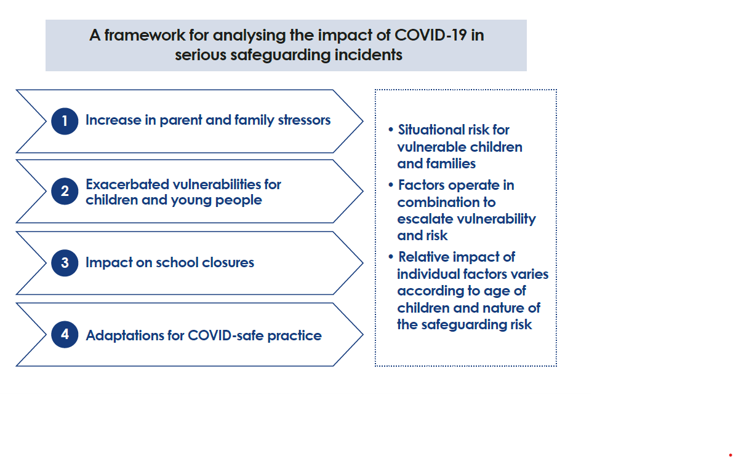

Slide 7
The impact of COVID-19 on families and services – evidence from published commentary / stakeholder research
An increase in parent and family stressors
There were increased pressures on families as a result of disrupted routines and behaviors; overcrowding; isolation from family support networks; and financial pressures. Tensions in family relationships resulted in an escalation in domestic violence.

Slide 8
The impact of COVID-19 on families and services
Exacerbated vulnerabilities for children and young people
An extended period out of school, away from friends and trusted adults outside the home, exacerbated children and young people’s vulnerabilities during the COVID-19 outbreak. There were concerns about ‘children below the radar’ who may have become vulnerable during lockdown and were not currently known to any service.

Slide 9
The impact of COVID-19 on families and services
Impact of school closure: identification, contact with and support for vulnerable children and young people
Government guidance in March 2020 set out a framework for supporting vulnerable children and young people, with an expectation that they would continue to attend school.
In practice, for a variety of reasons, school attendance by vulnerable pupils was very low).
During the early stages of the first lockdown Evidence suggests there were significant variations in the extent to which schools were in contact with and supporting vulnerable children and families

Slide 10
The impact of COVID-19 on families and services
Impact of adaptations for COVID-safe practice
Authorities put in place innovative arrangements for:
‘virtual’ home visits,
supervision,
and team meetings.
Face-to-face home visiting continued for priority cases.
Research evidence has highlighted opportunities for different and more effective engagement with vulnerable children and families as a result of these adaptive changes.
Notes:
There were nevertheless concerns that ‘virtual visits’ were not always effective in assessing changing risk and need. During COVID-19 a number of specialist services were limited or unavailable, thus reducing the scope for, and impact of, coordinated multi-agency support for children and families.

Slide 11
Summary of Findings
Practitioner working
There were good examples of Safeguarding Partnerships taking the learning from Rapid Reviews to make immediate changes in COVID-19 protocols for practitioners. For example,
local authorities,
working with Safeguarding Children Partnerships, established clear frameworks for risk assessment, identifying and sharing information about vulnerable children.
Practitioners were also enabled to engage remotely with families and in working with one another.

Slide 12
Summary of Findings
Parental and family stressors :
These were major factors across the full range of cases involving COVID-19.
Increasing domestic violence and
mental health concerns were key features across the Rapid Reviews.
The lack of contact with extended family members during lockdown meant the loss of a key protective factor in some cases.
In others, family dynamics changed where a new partner joined the household to avoid lockdown contact restrictions.
Reviews highlighted pressures and tensions as a result of disrupted routines and overcrowding.

Slide 13
Summary of Findings
Harm to babies under 12 months old
Babies under 12 months old continue to be the most prevalent group notified, and there were a high proportion of cases involving non-accidental injury and sudden unexpected infant death.
In these cases, parental and family stressors were the most significant factor in escalating risk.
In some of the cases, face-to-face visits had been replaced with telephone or video contact.
It is important that families with newborns during lockdown have at least one face-to-face visit from a midwife and health visitor.

Slide 14
Summary of Findings
Young people’s mental health
Being away from the support of friends,
trusted adults and school appeared to have a particular impact on children and young people’s mental health and was evident in all cases of suicide.
Reviews highlighted incidents of self-harm, exposure to sexual abuse and online bullying.

Slide 15
Summary of Findings (School closures)
Rapid Reviews provided mixed evidence of the impact of local authorities and schools in identifying and supporting vulnerable children and young people.
There were some good examples where schools had
maintained contact,
promoted study support and other activities,
and adapted their approach in line with evolving national guidance and expectations.
However, many vulnerable children who were entitled to attend school were kept at home by parents fearing risk of COVID-19 infection.
This meant children lost structure and routine where parents’ capacity to provide home schooling was limited.

Slide 16
Summary of Findings (School Closures)
Additionally, children at home full-time was an added pressure for the parents, particularly for carers with disabled children.
School was not available as a source of support or as a trusted environment for children to disclose concerns; as a result, some vulnerable children remained ‘below the radar’.
In any future lockdown period, it is essential that schools remain open for all children, with clear messaging for parents about COVID-safe learning environments, and expectations of normal attendance.

Slide 17
Summary of Findings (Adaptations for COVID-safe practice )
Adapting practice was an important factor across the full range of cases involving COVID-19. Typically, this related to circumstances :
where face-to-face home visits or booked appointments were replaced by telephone contacts or virtual visits.
However, service closures, deferred appointments and delays in decision-making were also evident.
On occasion, visits were delayed or cancelled owing to a lack of Personal Protective Equipment (PPE).

Slide 18
Summary of Findings Adaptations for COVID-safe practice
Rapid Reviews highlighted examples of the effective use of ‘virtual home visits’ by video link.
Where these worked well:
practitioners were able to observe children and adult-child interaction,
assess the home environment,
and use focus questions to assess changing risk and need.

Slide 19
Going Forward
Practitioners would benefit from the development of practice guidance and best practice standards for virtual visits,
Also, local authorities and partner agencies anticipate moves to a more blended approach to contact with children and families.

Slide 20
FURTHER SUPPORT
Rozeena Vander Waal, Funding and Group Development Officer & Safeguarding Lead : rozeena@ehcvs.org.uk
Work Mobile Number: 07869381301
Further support in 1-2-1 sessions is available

