Slide 1

Hounslow Community Network Annual Conference
Presentation
On work on Childhood Obesity and how the VCS are vital in supporting health initiatives
Hounslow and Richmond Community Healthcare NHS Trust
Jennifer Banks-Smith Health and Wellbeing Manager
and Gopika Chandratheva Nutritionist

Slide 2
One You Hounslow Digital Platform
Cook and Eat Sessions
Health Adviser Goal Setting
Community Outreach (mini health checks)
Blood Pressure Screening
Exercise on Referral
Universal Physical Activities
Stop Smoking
Smart Phone Apps
Social Prescription
Change 4 Life Programme 5 – 19 Years

Slide 3
Hounslow obesity figures
JSNA 2017
‘Obesity in children and adults is a priority need. 1092 Year 6 children and123,000 adults are overweight’
‘More socio-economically deprived children are more likely to be overweight but Hounslow’s children are no different from the rest of London with 1 in 5 children being overweight at the age of 5, and 1 in 3 being overweight at the age of 10’
‘Today nearly a third of children aged 2 to 15 are overweight or obese and younger generations are becoming obese at earlier ages and staying obese for longer’-Childhood obesity plan 2017

Slide 4
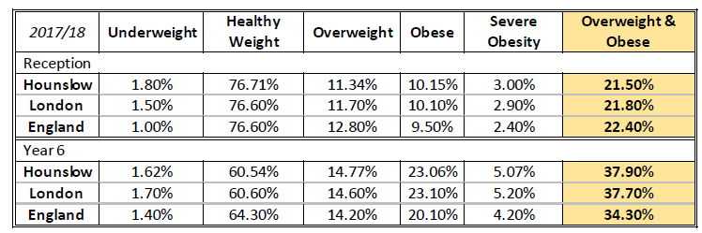
Hounslow obesity figures
NCMP 2017/18

Slide 5
Obesity Causes

Slide 6
Types of Programmes
School based 8 week programme
Inclusion= primary and secondary, healthy weights as well
Community based 8 week programme-Those referred into the service
Inclusion=overweight’s

Slide 7
Benefits of Programme
Can be delivered in other languages to tailor the needs of the multi cultural borough
Collaborate with school nurses and health visiting to target schools with high levels of obesity
Channel families into UPA, cook and eat and walking programme
Partnership with voluntary sector:
INS, Youth centre, BFCCST, Age UK, Fusion, Afghan group, Hounslow Housing Tenants, Hounslow respiratory support group, LD Provisions
Universal

Slide 8
Change4life Programme Overview
Digital Marketing | National Change4life Campaign: sugar smart app, 10 minute shake up, meal and recipe planner
Theme | 5 A DAY, Active time and routine
Pre -programme | Referrals, registrations, height, weight and BMI check (for programme criteria), pre course evaluation on healthy behaviours
Week | 1 | 2 | 3 | 4 | 5 | 6 | 7 | 8
 | Parent nutrition session
Topic | A balanced diet and promoting the Eatwell plate & the obesogenic environments | Sedentary behaviour and goal setting (SMART, short, medium and long term goals) | Eating habits and understanding hunger and fullness | Understanding food labelling/making healthier choices | Modifying favourite traditional/comfort foods, budgeting, and reducing unhealthy foods consumed outside | Supermarket tour activity | Family physical activity session | Family physical activity session
8 week family weight management programme (5 – 13) age group
Digital Marketing | National Change4life Campaign: sugar smart app, 10 minute shake up, meal and recipe planner
Theme | 5 A DAY, Active time and routine
Pre -programme | Referrals, registrations, height, weight and BMI check (for programme criteria), pre course evaluation on healthy behaviours
Week | 1 | 2 | 3 | 4 | 5 | 6 | 7 | 8
 | Parent nutrition session
Topic | A balanced diet and promoting the Eatwell plate & the obesogenic environments | Sedentary behaviour and goal setting (SMART, short, medium and long term goals) | Eating habits and understanding hunger and fullness | Understanding food labelling/making healthier choices | Modifying favourite traditional/comfort foods, budgeting, and reducing unhealthy foods consumed outside | Supermarket tour activity | Family physical activity session | Family physical activity session
Sub topics | Self-esteem, self-confidence, body image, social issues surrounding food and sedentary behaviour (pester power) practical solutions for lapses and high risk situations, support mechanisms
 | Physical activity session for 5 – 7, 8-10, 11 - 13 years olds
Activities | BFCCST physical activity sessions | BFCCST physical activity sessions | BFCCST physical activity sessions | BFCCST physical activity sessions | BFCCST physical activity sessions | BFCCST physical activity sessions | Family physical activity session | Family physical activity session
5 – 7 year olds | Fitness Testing | Learn how to use their goals for exercise. (simple) Team games, Must keep moving, using balls, if sedentary there team loses points. Teams must set goals | Learning to make exercise a habit. (Simple) Team Games, Must set up a routine within their teams. Talk about doing exercise at least once a day for 60 minutes. | Making better travel choices (simple) Team Games, Traffic lights, when is it right to run, walk, stop? Use footballs or some ball activity. | Good and Bad foods(simple) Team Games, Basketball hoops or a target, Collecting healthy foods and bad foods if they miss. | Shopping trip (simple) Team Games, Hoop game, need to run towards the correct hoops with the right foods. | Family competition games Mini Olympics | Fitness Testing
8-10 year olds | Fitness Testing | Learn how to use their goals for exercise. (simple) Team Games Must keep moving, using balls, if sedentary there team loses points. Teams must set goals. last 10 minutes learning about body weight exercises | Learning to make exercise a habit. (Simple) Team Games, Must set up a routine within their teams. Talk about doing exercise at least once a day for 60 minutes. Last 10 minutes learning about body weight exercises | Making better travel choices (simple) Team Games, Competition Games, Rounder’s Who can make the right decision to travel? Last 10 minutes learning about body weight exercises | Favourite sports/ exercises (simple) Team Games, Basketball hoops or a target, Collecting healthy foods and bad foods if they miss. last 10 minutes learning about body weight exercises | Shopping Trip (simple) Team Games, Hoop game, need to run towards the correct hoops with the right foods. | Family competition games Mini Olympics | Fitness Testing
11-13 year olds | Fitness Testing | Learn how to use their goals for exercise. (advanced) Million dollars to set up a physical activity. In groups have to play their own game. Play team games for the rest of the session. | Learning to make exercise a habit. (advanced) Circuit training, must do the circuit more than once so that they remember them. Emphasize making a habit of exercise. | Making better travel choices (advanced) Been giving the opportunity to come up with a time travel sequence must involve physical activity. Rounders, who can make the right decision to travel. | Favourite sports/ exercises (advanced) Team Games, Basketball hoops or a target, Collecting healthy foods and bad foods if they miss. Last 20 minutes circuit | Shopping Trip (Advanced) Team Games, Hoop game, need to run towards the correct hoops with the right foods. Use numbers for calories | Family competition games Mini Olympics | Fitness Testing
On-going support | Facebook group, whatsapp group, change4life/One You Hounslow website, 7-7, 7 days a week helpline, get active Hounslow website
Exit strategies | BFCCST activities Every step counts ( 12 week closed group walking programme) Partner activities e.g. Sport Impact, Fusion, Motivate Hounslow Behaviour change apps e.g. better points
Follow up | 6 & 12 months: height, weight and BMI check, post course evaluation on healthy behaviours

Slide 9
Eligibility Criteria
Age 5-19
GP, or School or live in Hounslow
Have a BMI equal to or greater than the 91st centile

Slide 10
Exclusion Criteria
Individuals with the following criteria (unless deemed appropriate by specialist staff) should be excluded from this service:
• Have an eating disorder
• Individuals with an underlying medical cause for obesity and those who would benefit from more intensive clinical management than a tier 2 service
• Children with more complex needs such as learning difficulties and mental health issues should be considered on a case by case basis
Refer on to appropriate health professional if needs are complex i.e. autistic

Slide 11
Referral Pathway
Phone
Website
Email

Slide 12
Results 2018/2019

Slide 13
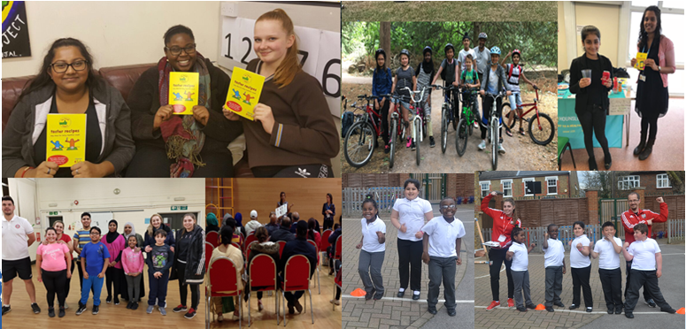
Highlights from 2017-18
Children Weight Management

Slide 14
Follow up
On-going support | Facebook group, whatsapp group, change4life/One You Hounslow website, 7-7, 7 days a week helpline, get active Hounslow website
Exit strategies | BFCCST activities and engage with local voluntary group activities Every step counts ( 12 week closed group walking programme) Partner activities e.g. Sport Impact, Fusion, Motivate Hounslow Behaviour change apps e.g. better points
Follow up | 6 & 12 months: height, weight and BMI check, post course evaluation on healthy behaviours

Slide 15
Launch of cook and eat
So far we have worked with BFCCST, Age UK, Hounslow Youth Club, Afghan group, Fusion, Hounslow Multi Cultural Centre, Learning Disability Provisions, Hounslow Housing Tenants and Sheltered Housing.
Aim-4 week course to help people cook more healthy and reduce risk of CVD, high cholesterol, obesity, high blood pressure and diabetes.
Over 300 people have attended our free Cook and Eat sessions over the last year.
The Cook and Eat sessions have proved very popular and the dietitian and nutritionist have had excellent feedback about the sessions.
These sessions have been a great way to reach out to all members of the local community included those with hearing and sight impairments.
Cook and eat has had an impact on clients and referrals have increased for our change4life programmes via cook and eat and having an impact on families as a whole.

Slide 16
Innovative health and wellbeing service for Hounslow which include the voluntary sector
Partnership working – promoting PH campaigns with voluntary sector
Introduction to cook and eat sessions in schools, voluntary sector and community venues
Relaunch of Health Walks across the borough with voluntary sector
Website development and redesign
Real time activities for UPA in partnership with voluntary sector
Introduction of drinks checker on OYH website and promote throught voluntary sector.

Slide 17
Thank you
Any questions

