Slide 1

Thriving Communities Strategy (2019 - 2023)
Hounslow Community Network
27 November 2019
Community Partnerships Unit
Community.development@Hounslow.gov.uk

Slide 2

Community Partnerships Unit
Supporting a strong, active and cohesive community
Launched in June 2019
Hounslow Community Network AGM : 27 November 2019

Slide 3
Thriving Communities Strategy (2019 - 2023)
Community Partnerships Unit
Supporting a strong, active and cohesive community
Building on the successes of the previous strategy
  Taken on board the feedback over four years of previous strategy
  Shorter
  Streamlined - clear messages about the council’s aims
  Retains the distinctive integrated structure of the current strategy
  Buy in from across the council
  …and the VCSE sector
Hounslow Community Network AGM : 27 November 2019
33

Slide 4
Community Partnerships Unit
Supporting a strong, active and cohesive community
We have identified 6 building blocks of a Thriving Community
Hounslow Community Network AGM : 27 November 2019

Slide 5
Community Partnerships Unit
Supporting a strong, active and cohesive community
Building blocks of a thriving community
Effective social action and volunteering | Opportunities for people to make a difference where they live, study or work through volunteering or social action.
Strong and sustainable community groups | An active and sustainable voluntary and community sector, supporting local communities in partnership with the council.
A strong and influential community voice | People are involved in the design and delivery of services and in the shaping of their community.
Good quality community facilities and services | Accessible, affordable and good quality spaces are available for community use.
Safe and respectful community relations | A cohesive community, where people have a sense of belonging and feel safe, regardless of their background.
Everyone plays their part in the community | All stakeholders make an active contribution to improving the community.

Slide 6
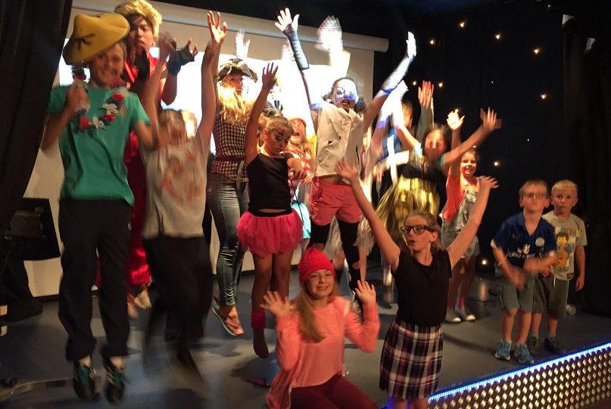
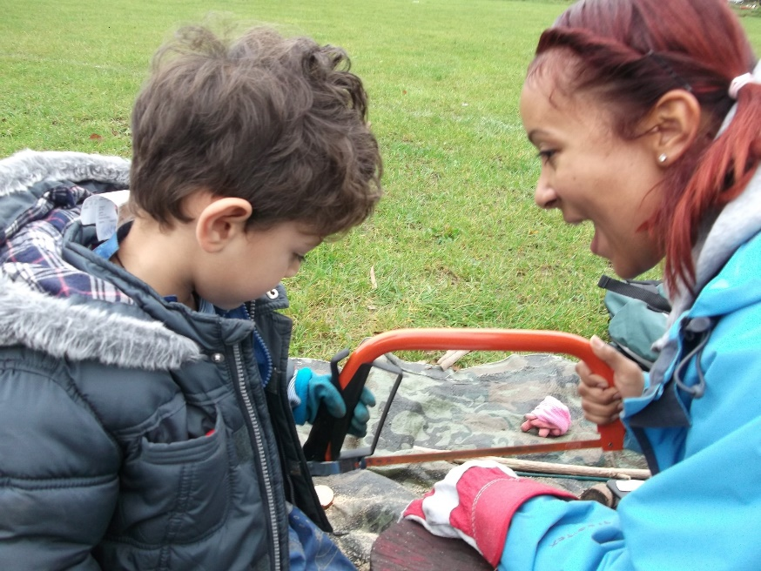
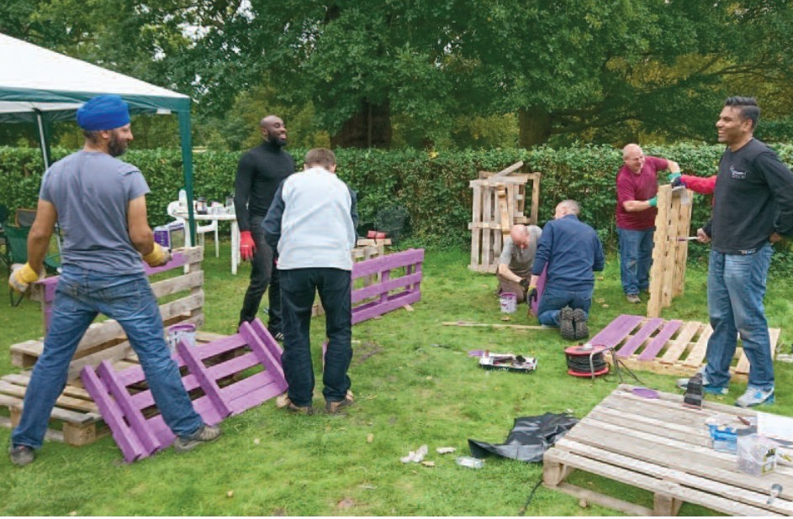
Community Partnerships Unit
Supporting a strong, active and cohesive community
Working with HCN will be essential
Provide regular updates
Hounslow Community Network AGM : 27 November 2019

Slide 7

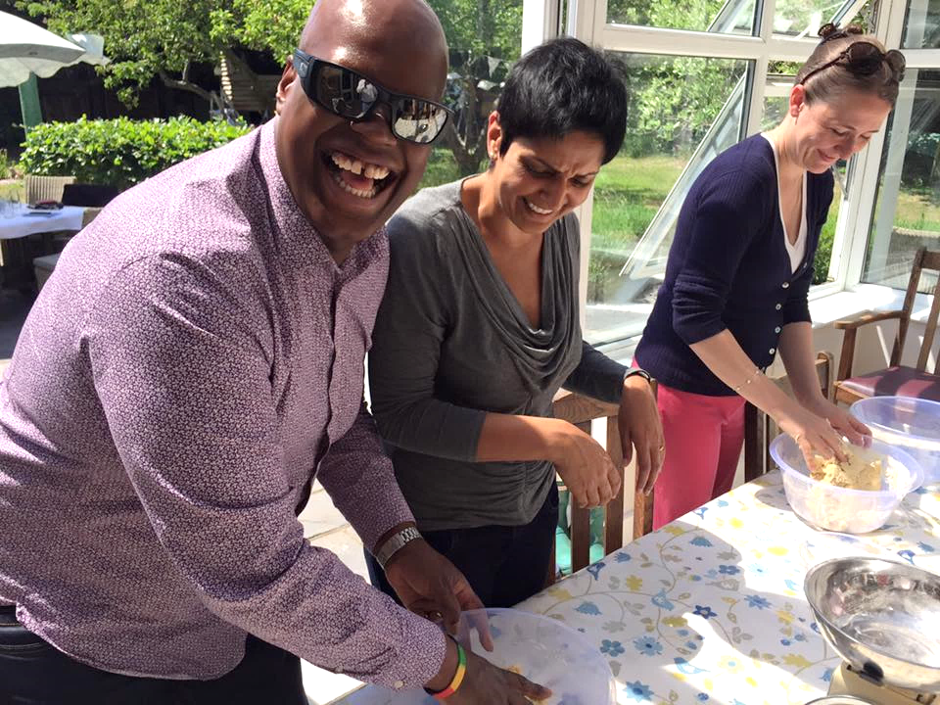
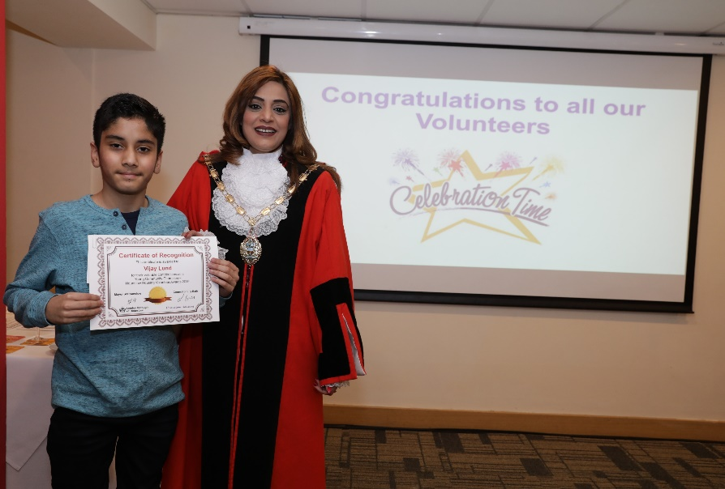
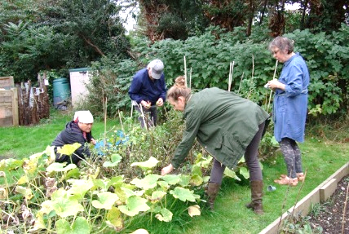
Community Partnerships Unit
Supporting a strong, active and cohesive community
We are commissioning a volunteering brokerage service with the aim of increasing the levels of volunteering.
Our community engagement team is currently running a survey on all of the estates, to help residents get into volunteering.
Hounslow Community Network AGM : 27 November 2019

Slide 8
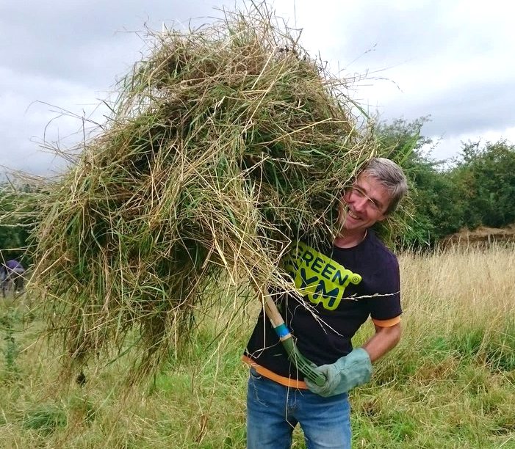
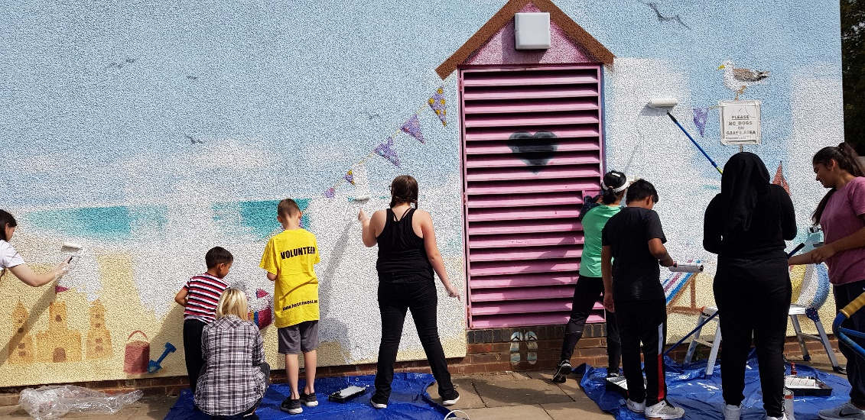
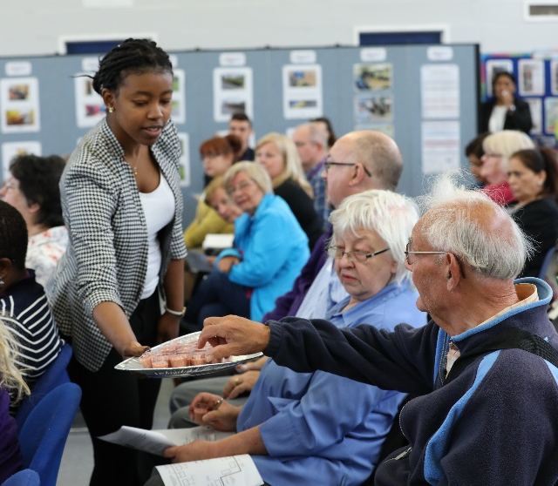
Community Partnerships Unit
Supporting a strong, active and cohesive community
The new Thriving Communities Fund will be up and running in the New Year.
Currently following up on the feedback that we received in the annual VCSE sector survey
In the process of commissioning a local infrastructure support service that best meets the future needs of the VCSE sector.
Hounslow Community Network AGM : 27 November 2019

Slide 9
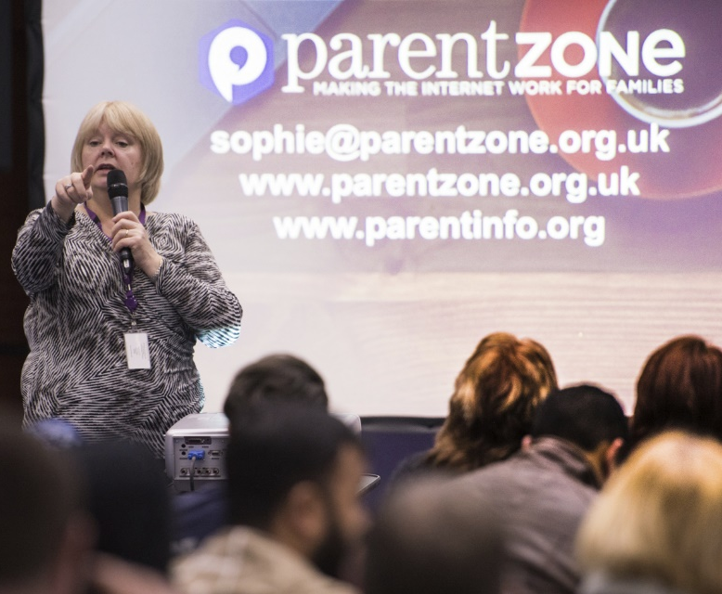
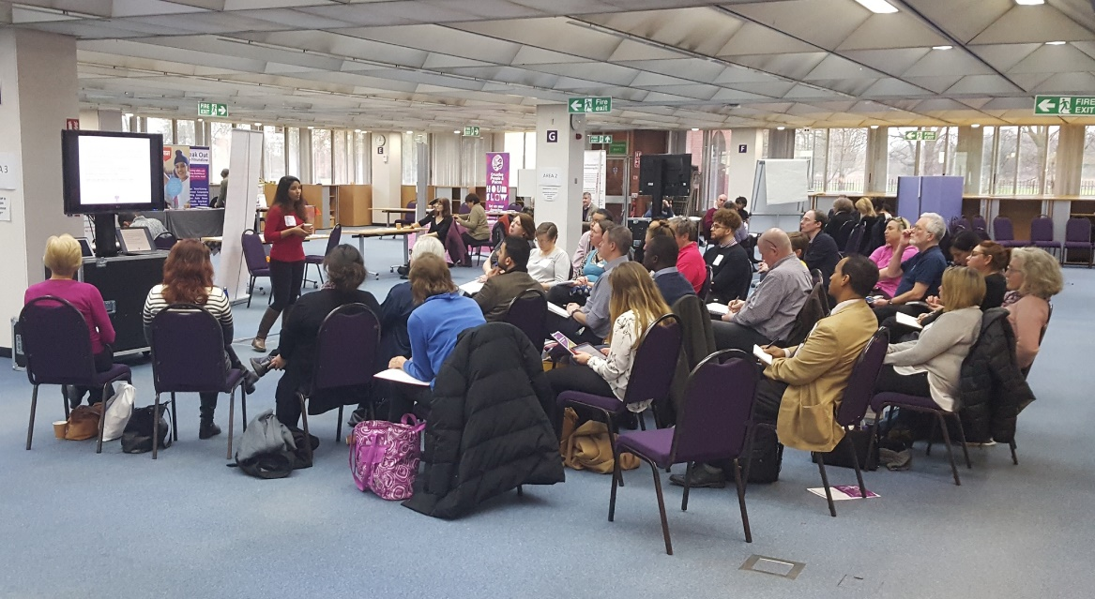
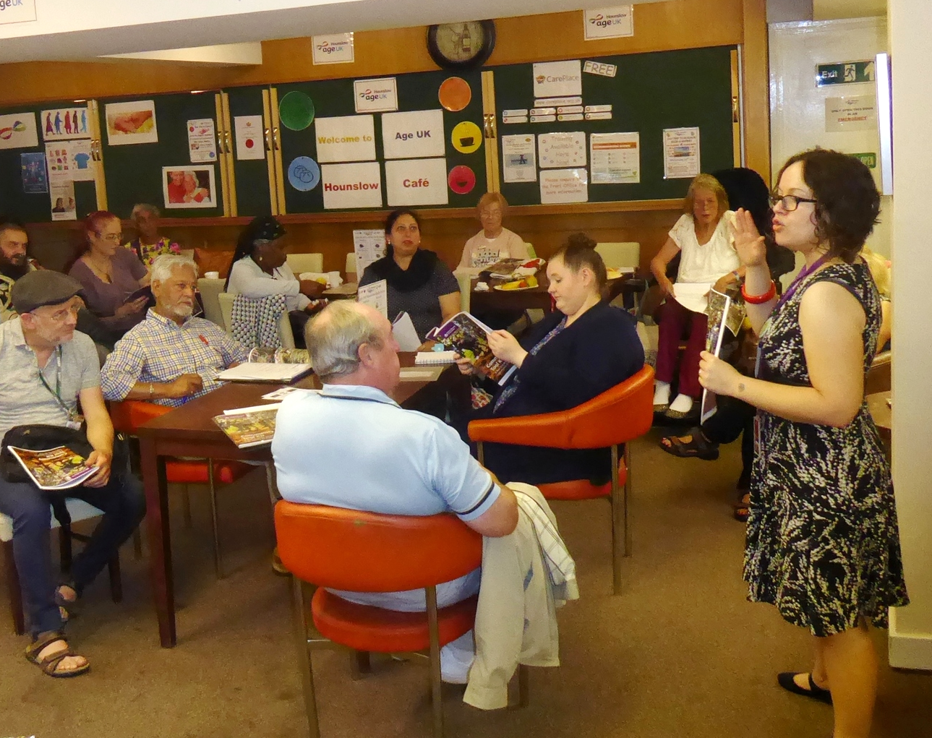
Community Partnerships Unit
Supporting a strong, active and cohesive community
We
In the New Year the council will be undergoing a thorough review of how we communicate and engage with residents.
The volunteer estate inspection scheme is continuing to grow – giving residents on estates a say in how their services are delivered.
Hounslow Community Network AGM : 27 November 2019

Slide 10
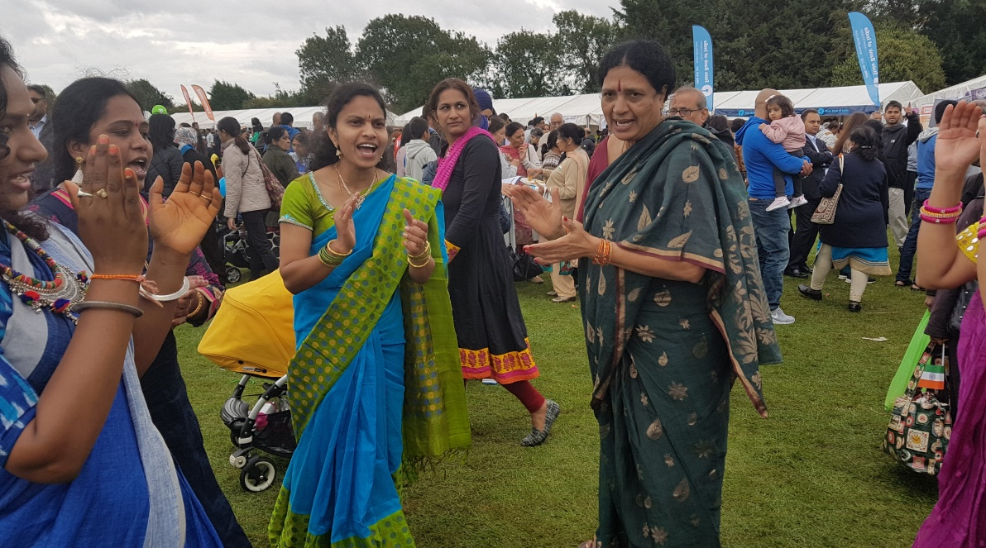
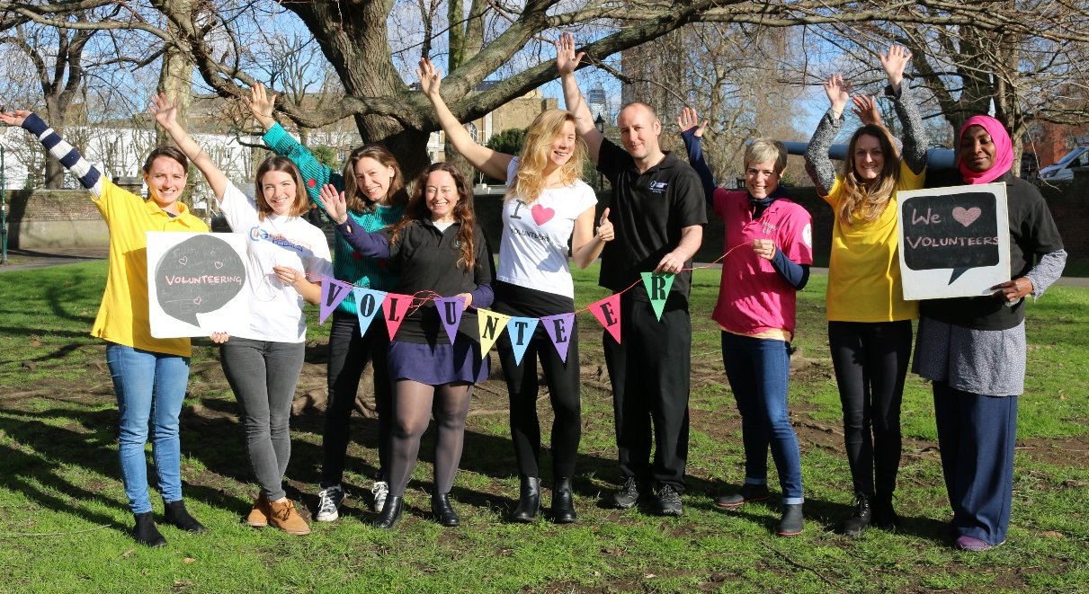
Community Partnerships Unit
Supporting a strong, active and cohesive community
We
We are building a guide of available community spaces across the Borough and how to hire them through our new Community Information Guide.
We would welcome the help of HCN getting members to register on the CIG.
Hounslow Community Network AGM : 27 November 2019

Slide 11
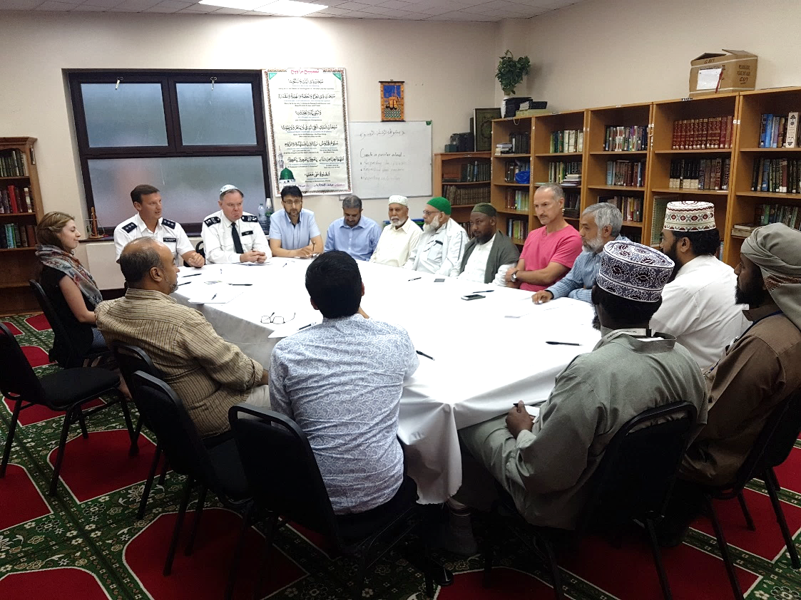
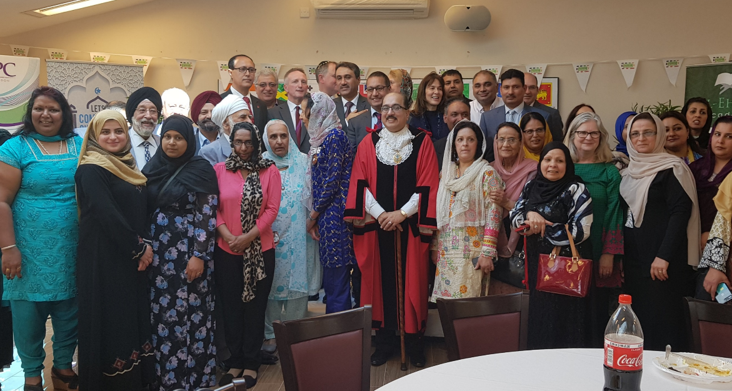
Community Partnerships Unit
Supporting a strong, active and cohesive community
We
The new Hounslow Giving project is well underway and the website will be live in the New Year. Will bring together stakeholders in the community - residents, community and voluntary organisations, businesses, funders and public bodies.
Hounslow Community Network AGM : 27 November 2019

Slide 12
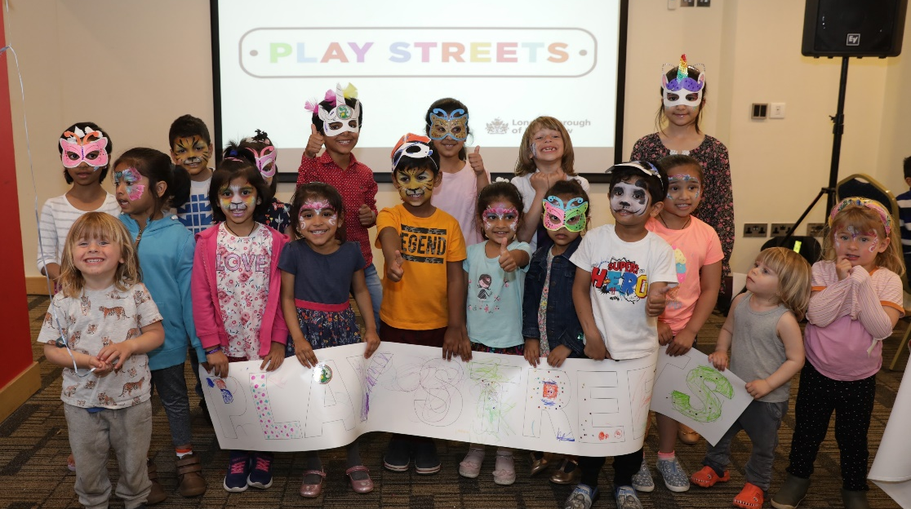
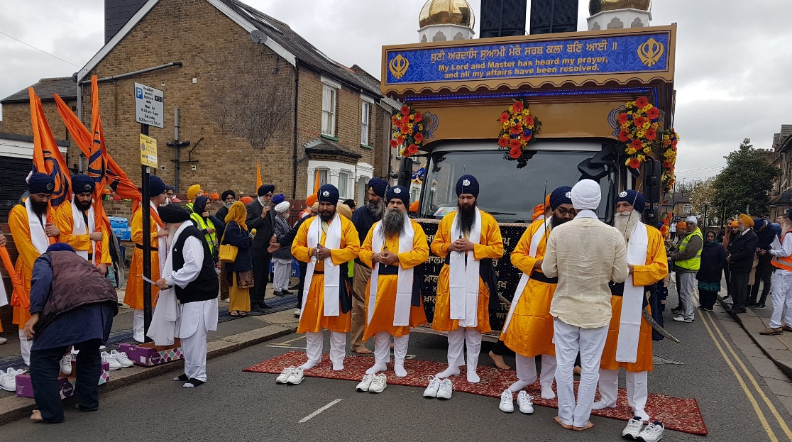
Community Partnerships Unit
Supporting a strong, active and cohesive community
We
In the New Year we will be rolling out a fast-track training programme to community groups about community cohesion and counter extremism.
Our Community Cohesion Partnership Group meets regularly to bring together different communities from across the borough.
Hounslow Community Network AGM : 27 November 2019

Slide 13
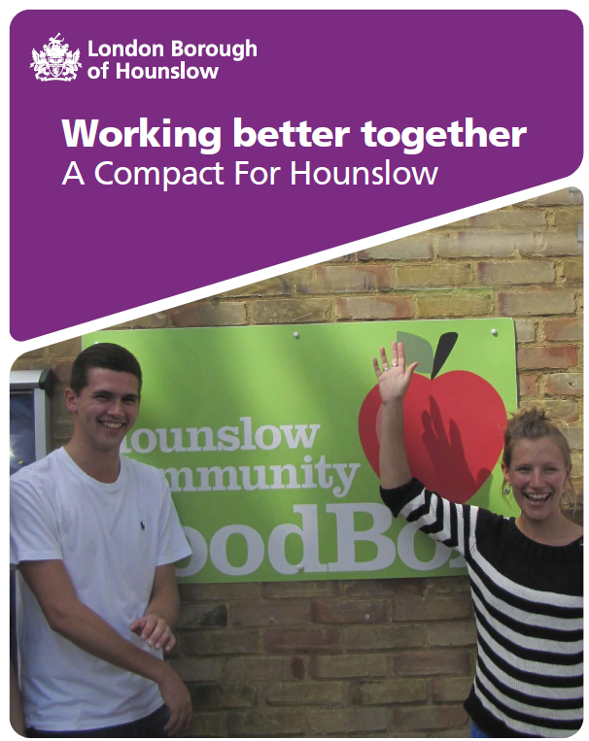
Community Partnerships Unit
Supporting a strong, active and cohesive community
We
Working together
The partnership agreement between public bodies and the VCSE sector in the borough
Rewritten a couple of years ago in partnership with HCN
Exists to promote the proactive role of the VCSE sector
Raise awareness of the Compact and sign up to it.
Hounslow Community Network AGM : 27 November 2019

Slide 14
Community Partnerships Unit
Supporting a strong, active and cohesive community
We
Thank you – are their any questions?
Hounslow Community Network AGM : 27 November 2019

